Slide 1
Unit 11 American Federalism
English for Lawyers II
Snježana Husinec, PhD., shusinec@pravo.hr

Slide 2
Forms of government organization
What is a unitary state and what a federation?
Do you know of any other form of government organization?
UNITARY STATE – a state whose three organs of state are governed as one single unit with one legislature and one parliament with local administrative branches
FEDERATION – a union comprising a number of partially self-governing states or regions united by a central (“federal”) government – multiple levels of government
CONFEDERATION – an association of sovereign states or communities, usually created by treaty by which they delegate certain powers to common institutions; often later adopt a common constitution (central issues usually – defense, foreign affairs, foreign trade, common currency)

Slide 3
The United States of America
the world's third largest country in population and in area
Land area: 9,166,601 sq km; Total area: 9,631,420 sq km
Population (2009 est.): 307,212,123 , birth rate: 13.8/1000; life expectancy: 78.1; density per sq mi: 85
Government: a federal constitutional republic
- 50 states + 1 federal district (District of Columbia)
- founded by 13 colonies of Great Britain in 1787 (by the
Constitution of the United States)
Capital: Washington, DC
President: Donald Trump
Vice President: Mike Pence
Legislature: United States Congress

Slide 4
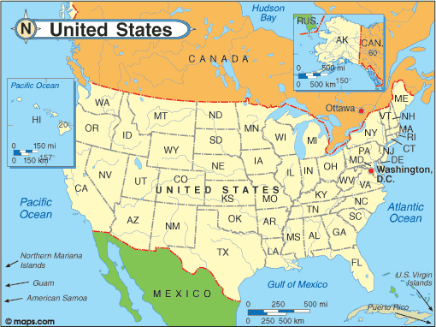

Slide 5
What do you know about the following events/people/documents in the early US history?
The Boston Tea Party
American Revolutionary War
Declaration of Independence
Articles of Confederation
Constitutional Convention
U.S. Constitution
George Washington
Bill of Rights

Slide 6
The United States of America - early history in brief
1773 The Boston Tea Party: an act of rebellion against British rule (taxes but no
representation in the Parliament)
1775–1783 - American Revolutionary War: War of independence fought between
Great Britain and the 13 British colonies on the eastern seaboard of North America
1776 Declaration of Independence adopted in Philadelphia (July 4)
1777 Articles of Confederation, the first U.S. constitution adopted – a weak CONFEDERAL
government
1783 Treaty of Paris - Great Britain formally acknowledges American independence
1787 Constitutional Convention, made up of delegates from 12 of the original 13 colonies,
meets in Philadelphia to draft the U.S. Constitution – a strong national FEDERAL
government with powers of taxation
1789 George Washington is unanimously elected president of the United States
U.S. Constitution - ratified by nine states
1791 First ten amendments to the Constitution, known as the Bill of Rights, are ratified
1861-1865 Civil War: Conflict between the North (the Union) and the South (the
Confederacy) over the expansion of slavery into western states

Slide 7
The Federal System
Scan the text and do ex. II.

Slide 8
The Declaration of Independence (1776)
document that established the new nation of the United States (accepted by the Continental Congress, July 4, 1776); severed the ties of 13 colonies to the British Crown; drafted (almost entirely) by Thomas Jefferson
Consists of three parts
A) a preamble (a declaration of individual rights )
“We hold these truths to be self-evident, that all men are created equal,
that they are endowed by their Creator with certain unalienable Rights,
that among these are Life, Liberty and the pursuit of Happiness.”
B) a list of grievances or justifications for seeking independence (lists the acts of tyranny by George III)
C) the point of all that preceded
“the good People of these Colonies, solemnly publish and declare, That these United Colonies are, and of Right ought to be Free and Independent States”

Slide 9
Constitution of the United States of America
the final document of the Constitutional Convention; came into force in 1789
US BECAME A FEDERAL STATE
INTRODUCED SEPARATION OF POWERS
BICAMERAL LEGISLATURE - PROPORTIONAL REPRESENTATION IN THE HOUSE OF REPRESENTATIVES, EQUAL IN THE SENATE
REPRESENTATIVES ELECTED BY THE PEOPLE IN DIRECT (POPULAR) ELECTION, SENATORS BY STATE LEGISLATIONS IN INDIRECT ELECTIONS
the pattern of allocation of powers between the federal and state governments was worked out
judicial veto was introduced
constitution + treaties – “the supreme law of the land, and the judges in every state shall be bound thereby”
primary responsibility for the conduct of foreign affairs in the hands of the president
president – commander in chief of the armed forces
electoral college to select the president – to ensure the executive independent of the national legislature
STILL IN FORCE – TO DATE 27 AMENDMENTS
The Making of the Constitution https://www.youtube.com/watch?v=OSWl5ldEv6w

Slide 10
U.S. Constitution
7 articles + 27 amendments
Article I – The Legislative Branch (Sections 1 – 10)
Article II – The Executive Branch (Sections 1 – 4)
Article III – The Judicial Branch (Sections 1 – 3)
Article IV – Relations between the states and between each state and the federal government (Sections 1 – 4)
Article V – The process for amending the Constitution
Article VI – The supreme law of the land
Article VII – The Ratification Procedure

Slide 11
American federalism and allocation of powers
FEDERALISM
a basic structural feature of the American political system;
has generated a great deal of conflict throughout American political history
involves multiple layers of government with shared powers among them and powers unique to each of the levels of government
Division of powers between
a) federal government– has the powers enumerated in the Constitutions
b) state governments– PLENARY POWER (complete and absolute power without limitations)
The federal government - three branches:
a) the executive
b) the legislative
c) the judicial

Slide 12
The Tenth Amendment (1791)
a part of the Bill of Rights, ratified in 1791
“The powers not delegated to the United States by the
Constitution, nor prohibited by it to the States, are reserved
to the States respectively, or to the people.”
defines the relationship between the national and state governments
grants certain powers to the federal government (enumerated in the Constitution) and reserves the rest for the states – states have PLENARY POWER
the federal government is supreme with regard to those powers expressly or implicitly delegated to it, the states remain supreme in matters reserved to them.
SEPARATE SUPREMACY – the supremacy of each government in its own sphere – each government is sovereign in its own right

Slide 13
The U.S. Bill of Rights (1791)
the first 10 amendments to the Constitution
written in response to calls from several states for greater constitutional protection for individual liberties - lists specific prohibitions on governmental power
eg. the right to free speech and religion (1st Amendment);
the right to be free from unreasonable government intrusion
in one’s home (4th Amendment) etc.
See full text: https://www.billofrightsinstitute.org/founding-documents/bill-of-rights/

Slide 14
Division of powers
National (federal) powers:
declaring war
making treaties (foreign relations)
controling imports and exports
State powers:
- all powers that are not delegated to the federal government (spelled out in the Tenth Amendment)
Concurrent powers (shared by bothe levels of government)
taxation
business regulation
environmental protection
civil rights

Slide 15
The Federal System
Read the first 3 sections of the text and answer question 1-6 in ex. III.

Slide 16
Vocabulary practice I
Fill in the gaps with appropriate terms.
treaties - division - veto - consent -
nation - independently - authority
The key to the constitution was the distribution of political
____________ – separation of powers among the executive, legislative,
and judicial branches of the nationa government, and ____________of
powers between states and _____________. The branches were balanced
against one another, their powers deliberately entwined to prevent them
from acting ______________. The president was given a
______________over congressional legislation, but his ____________ and
major appointments required the ____________ of the Senate

Slide 17
Vocabulary practice I - Key
The key to the constitution was the distribution of
political authority – separation of powers among the
executive, legislative, and judicial branches of the
nationa government, and division of powers between
states and nation. The branches were balanced against
one another, their powers deliberately entwined to
prevent them from acting independently. The
president was given a veto over congressional
legislation, but his treaties and major appointments
required the consent of the Senate.

Slide 18
The
LEGISLATIVE
BRANCH
Watch the following video clip and take notes on the structure and powers of the US legislature:
http//video.about.com/video/Overview-of-the-Legislative-Branch.htm

Slide 19
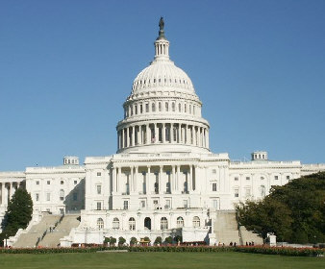
U.S. Congress
bicameral federal legislature – has two
branches
Article I of the Constitution:
All legislative Powers herein granted shall be vested in a Congress of the United States, which shall consist of a Senate and House of Representatives.
CONGRESS
the SENATE the HOUSE of
REPRESENTATIVES
(co-equal houses)
all congressmen (535) - both senators and representatives are chosen in DIRECT election

Slide 20
The Congress
Read the rest of the text and find the following:
Who does the House of Representatives represent?
Who does the Senate represent?
What are the powers of the Congress as a whole?

Slide 21
U.S. Congress - Powers
powers of the Congress – limited to those enumerated in the
Constitution; all other powers reserved to the states and the people
Article 1 - The Legislative Branch
Section 8
to lay and collect Taxes, Duties;
to regulate Commerce with foreign Nations, and among the several States, and with the Indian Tribes;
to coin Money;
to constitute Tribunals inferior to the supreme Court;
to declare War;
to provide and maintain navy;
to make rules for the government and regulation of the land and naval forces;
etc.
+ each house has some RESERVED powers

Slide 22
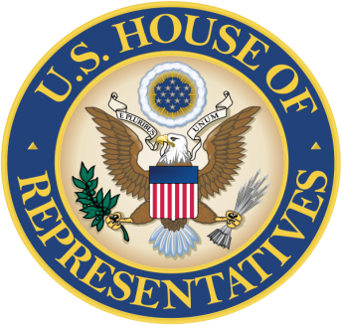
The House of Representatives
- composition and powers of the House are established in Article I Section 2 of the US Constitution Composition: - proportional representation (435 representatives) – seats apportioned among the states by the number of inhabitants (determined by census conducted every 10 years) - appointed for the term of office of 2 years;may be re-elected an unlimited number of times “The Number of Representatives shall not exceed one for every thirty Thousand, but each State shall have at Least one Representative.” - direct popular elections Reserved powers: - the sole Power of Impeachment - to propose bills on tax collection

Slide 23
U.S. Senate
- composition and powers of the Senate are established in Article I Section 3 of the US Constitution Composition: – two senators from each state – 100 senators serving staggered six-year terms (divided into 3 classes – every 2 years “one class shall be vacated” - so one third is chosen every second year – overlapping terms) - each senator has one vote - the Vice President of the US – President of the Senate – “shall have no vote, unless they be equally divided” - direct popular elections since 1913 (17th Amendment)
Reserved powers: - ratification of treaties - confirmation of presidential nominations to high-level judicial and executive positions - the sole power to try all impeachments

Slide 24
The Congress
Do ex. IV, V and VI on p. 98-99.

Slide 25
Vocabulary practice II
Complete the text about the United States Congress using the terms given below:
bicameral, vote, state, entitled, direct, term, passage, authority,
elected, legislature, senators
The United States Congress is the ____________ of the United States federal
government. It is ____________, comprising the House of Representatives (or simply the
House) and the Senate.
Each __________ is represented in the House proportionally to its population, and is
____________ to at least one representative. The total number of representatives is
currently fixed at 435, though Congress has the ________ to change that number. Each
representative serves for a two-year ________ and may be re-elected an unlimited
number of times. The House is often considered to be the "lower house," with the Senate
as the "upper house," although the United States Constitution does not use such
language. The Constitution provides that the approval of both houses is necessary for the
___________ of legislation.

Slide 26
Vocabulary practice II – cont.
Complete the text about the United States Congress using the terms given below:
bicameral, vote, state, entitled, direct, term, passage, authority,
elected, legislature, senators
In the Senate, each state has two __________. Therefore, there are 100
senators, serving staggered six-year terms. Every two years, approximately
one-third of the Senate is __________.The Vice President of the United States is
the President of the Senate and serves as its presiding officer, but is not a
Senator and does not _______.
Both Senators and Representatives are chosen through __________ election.

Slide 27
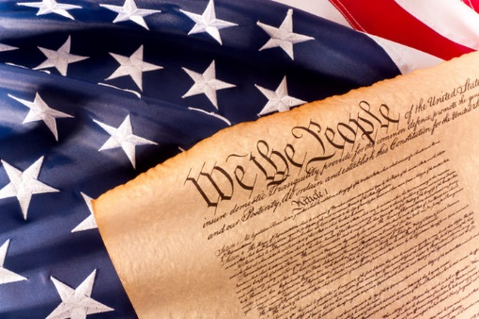
From the Constitution of the USA
Study th excerpt from the US Constitution and do exercises I – V.

