Slide 1
The admissibility of applications in front of the ECHR

Slide 2
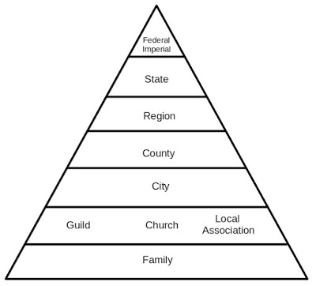
Protection of fundamental rights and freedoms
Established by the Convention.
The principle of subsidiarity (the task ensuring the application of the Convention falls primarily to the states – the ECHR acts only as a supervisory mechanism).
Supervision by Strasbourg is triggered mainly by individual applications (individuals or legal persons).
Individual – everyone living on the territory of the Council of Europe member states.

Slide 3
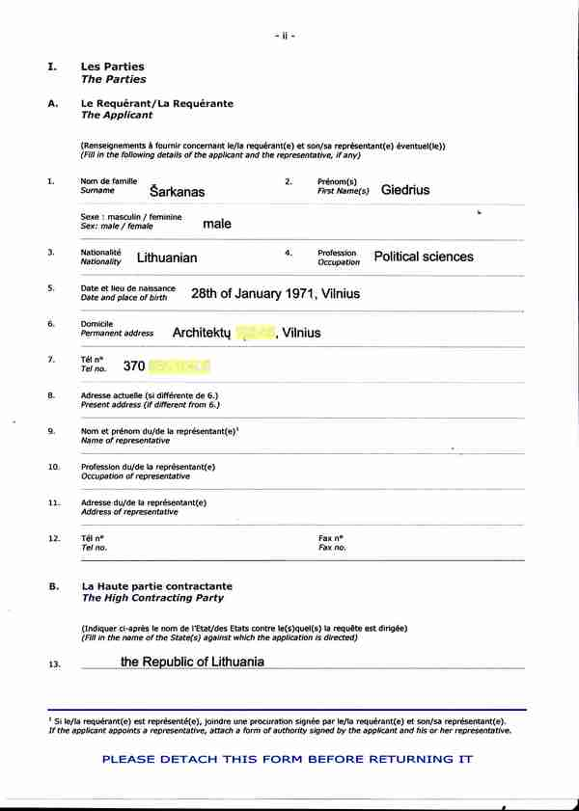
Individual application
Article 34 – Individual applications
“The Court may receive applications from any person, non-governmental organisation or group of individuals claiming to be the victim of a violation by one of the High Contracting Parties of the rights set forth in the Convention or the Protocols thereto. …”
Article 34 gives individuals a genuine right to take legal action at international level.
In order to rely on Article 34 of the Convention, an applicant must meet two conditions: he or she must fall into one of the categories of petitioners mentioned in Article 34 and must be able to make out a case that he or she is the victim of a violation of the Convention (Vallianatos and Others v. Greece [GC], § 47)

Slide 4
Categories of petitioners
1) Physical person
2) Legal person
3) Any group of individuals

Slide 5
Physical person
Any person may rely on the protection of the Convention against a State Party when the alleged violation took place within the jurisdiction of the State concerned, in accordance with Article 1 of the Convention (Van der Tang v. Spain, § 53).
Applications can be brought only by living persons or on their behalf; a deceased person cannot lodge an application (Aizpurua Ortiz and Others v. Spain, § 30; Dvořáček and Dvořáčková v. Slovakia, § 41), even through a representative (Kaya and Polat v. Turkey (dec.); Ciobanu v. Romania (dec.)).

Slide 6
Legal person
A legal entity claiming to be the victim of a violation by a member State of the rights set forth in the Convention and the Protocols has standing before the Court only if it is a “nongovernmental organisation” within the meaning of Article 34 of the Convention.
The term “governmental organisations” includes:
central organs of the state, decentralised authorities that exercise public functions ((Radio France and Others v. France (dec.), § 26),
part of a municipality in the exercise of public authority (Municipal Section of Antilly v. France (dec)),
legal entities which participate in the exercise of governmental powers or run a public service under government control (Kotov v. Russia [GC], § 93).

Slide 7
Any group of individuals
An application can be brought by a group of individuals. However, local authorities or any other government bodies cannot lodge applications through the individuals who make up them or represent them, relating to acts punishable by the State to which they are attached and on behalf of which they exercise public authority (Demirbaş and Others v. Turkey (dec.)).

Slide 8
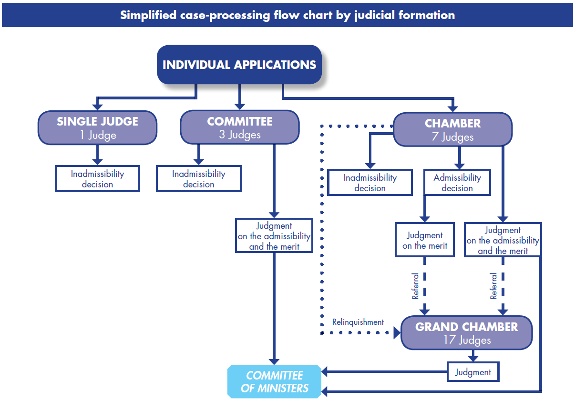

Slide 9
Victim status
The word “victim”, in the context of Article 34 of the Convention, denotes the person or persons directly or indirectly affected by the alleged violation.
Direct victim but also indirect victim.
In order to be able to lodge an application in accordance with Article 34, an applicant must be able to show that he or she was “directly affected” by the measure complained of (Tănase v. Moldova [GC], § 104; Burden v. the United Kingdom [GC], § 33).
However:

Slide 10
Indirect victim
If the alleged victim of a violation has died before the introduction of the application, it may be possible for the person with requisite legal interest as next-of-kin to introduce an application raising complaints related to the death or disappearance (Varnava and Others v. Turkey [GC], § 112).
The Court has accepted that close family members, such as parents, of a person whose death or disappearance is alleged to engage the responsibility of the State can themselves claim to be indirect victims of the alleged violation of Article 2, the question of whether they were legal heirs of the deceased not being relevant (Van Colle v. the United Kingdom, § 86).
The next-of-kin can also bring other complaints, such as under Articles 3 and 5 of the Convention on behalf of deceased or disappeared relatives, provided that the alleged violation is closely linked to the death or disappearance.

Slide 11
Potential victims and actio popularis
In certain specific situations, the Court has accepted that an applicant may be a potential victim. For example, where he was not able to establish that the legislation he complained of had actually been applied to him on account of the secret nature of the measures it authorised.
However, in order to be able to claim to be a victim in such a situation, an applicant must produce reasonable and convincing evidence of the likelihood that a violation affecting him or her personally will occur; mere suspicion or conjecture is insufficient (Senator Lines GmbH v. fifteen member States of the European Union (dec.) [GC]).
An applicant cannot claim to be a victim in a case where he or she is partly responsible for the alleged violation (Paşa and Erkan Erol v. Turkey).
The Court has also underlined that the Convention does not envisage the bringing of an actio popularis for the interpretation of the rights it contains or permit individuals to complain about a provision of a domestic law simply because they consider, without having been directly affected by it, that it may contravene the Convention (Aksu v. Turkey [GC], § 50; Burden v. the United Kingdom [GC], § 33).

Slide 12
Freedom to exercise the right of individual application
The right to apply to the Court is absolute and admits of no hindrance. This principle implies freedom to communicate with the Convention institutions.
The domestic authorities must refrain from putting any form of pressure on applicants to withdraw or modify their complaints.
Pressure may take the form of direct coercion and flagrant acts of intimidation in respect of applicants or potential applicants, their families or their legal representatives, but also improper indirect acts or contacts (Mamatkulov and Askarov v. Turkey [GC], § 102).

Slide 13
Obligations of the respondent State
Under Rule 39 of the Rules of Court, the Court may indicate interim measures (Mamatkulov and Askarov v. Turkey [GC], §§ 99-129). Article 34 will be breached if the authorities of a Contracting State fail to take all steps which could reasonably have been taken in order to comply with the measure indicated by the Court (Paladi v. Moldova [GC], §§ 87-92).
Whereas the Court is responsible for establishing the facts, it is up to the parties to provide active assistance by supplying it with all the relevant information. Their conduct may be taken into account when evidence is sought (Ireland v. the United Kingdom, § 161).
The respondent State is also expected to assist with investigations (Article 38), for it is up to the State to furnish the “necessary facilities” for the effective examination of applications (Çakıcı v. Turkey [GC], § 76). Obstructing a fact-finding visit constitutes a breach of Article 38 (Shamayev and Others v. Georgia and Russia, § 504).

Slide 14
Procedural grounds for inadmissibility
A. Non-exhaustion of domestic remedies
B. Non-compliance with the six-month time-limit
C. Anonymous application
D. Substantially the same
E. Abuse of the right of application
Incompatibility ratione personae
B. Incompatibility ratione loci
C. Incompatibility ratione temporis
D. Incompatibility ratione materiae

Slide 15
Non-exhaustion of domestic remedies
Article 35 § 1 concerns only domestic remedies; it does not require the exhaustion of remedies within the framework of international organisations.
The rationale for the exhaustion rule is to afford the national authorities, primarily the courts, the opportunity to prevent or put right the alleged violations of the Convention.
„The exhaustion rule may be described as one that is golden rather than cast in stone.” - ECHR (D.H. and Others v. the Czech Republic [GC], §§ 116-18).
Applicants are only obliged to exhaust domestic remedies which are available in theory and in practice at the relevant time and which they can directly institute themselves – that is to say, remedies that are accessible, capable of providing redress in respect of their complaints and offering reasonable prospects of success (Sejdovic v. Italy [GC], § 46).

Slide 16
Non-compliance with the six-month time-limit
Article 35 § 1 – Admissibility criteria
“1. The Court may only deal with the matter … within a period of six months from the date on which the final decision was taken.”
The six-month period runs from the final decision in the process of exhaustion of domestic remedies (Paul and Audrey Edwards v. the United Kingdom (dec.)).
The six-month period starts running from the date on which the applicant and/or his or her representative has sufficient knowledge of the final domestic decision (Koç and Tosun v. Turkey (dec.)).

Slide 17
Anonymous application
The applicant must be duly identified in the application form.
The Court alone is competent to determine whether an application is anonymous within the meaning of Article 35 § 2 (a) (Sindicatul Păstorul cel Bun v. Romania [GC], § 69).
An application to the Court is regarded as anonymous where the case file does not indicate any element enabling the Court to identify the applicant (“Blondje” v. the Netherlands (dec.).
If the applicants have submitted factual and legal information enabling the Court to identify them and establish their links with the facts in issue and the complaint raised – Art. 35 § 2 (a) does not apply.

Slide 18
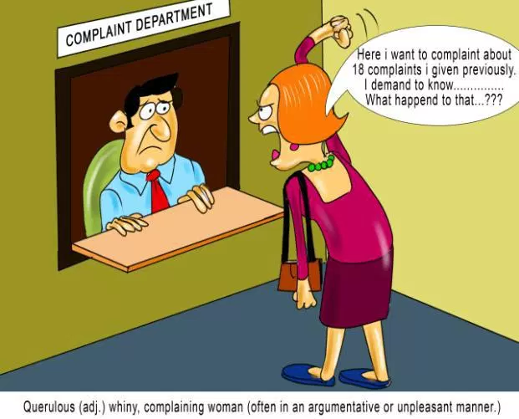
Substantially the same
An application or a complaint is declared inadmissible if it “is substantially the same as a matter that has already been examined by the Court … and contains no relevant new information”.
Also, if the complaint is substantially the same as a matter submitted to another procedure of international investigation or settlement, the Court’s jurisdiction is excluded.

Slide 19
Abuse of the right of application
An application is an abuse of the right of application if it is knowingly based on untrue facts with a view to deceiving the Court (Varbanov v. Bulgaria, § 36).
There will be an abuse of the right of application where the applicant, in his or her correspondence with the Court, uses particularly vexatious, insulting, threatening or provocative language – whether this be against the respondent government, its Agent, the authorities of the respondent State, the Court itself, its judges, its Registry or members thereof (Řehák v. the Czech Republic (dec.).
Intentional disclosure of confidential information (settlement).
Applicant repeatedly lodges vexatious and manifestly ill-founded applications with the Court that are similar to an application that he or she has lodged in the past that has already been declared inadmissible (M. v. the United Kingdom and Philis v. Greece, both Commission decisions).

Slide 20
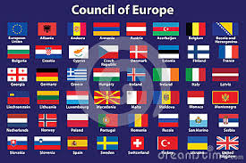
Incompatibility ratione personae
Compatibility ratione personae requires the alleged violation of the Convention to have been committed by a Contracting State or to be in some way attributable to it.
States may be held responsible for acts of their authorities, whether performed within or outside national boundaries, which produce effects outside their own territory (Drozd and Janousek v. France and Spain, § 91) - where a Contracting State is in effective control over an area or has at the very least a decisive influence over it (Catan and Others v. Moldova and Russia [GC], §§ 106-07).

Slide 21
Incompatibility ratione loci
Compatibility ratione loci requires the alleged violation of the Convention to have taken place within the jurisdiction of the respondent State or in territory effectively controlled by it (Cyprus v. Turkey [GC], §§ 75-81).
As regards applications concerning dependent territories, if the Contracting State has not made a declaration under Article 56 extending the application of the Convention to the territory in question, the application will be incompatible ratione loci (Gillow v. the United Kingdom, §§ 60-62).

Slide 22
Incompatibility ratione temporis
The provisions of the Convention do not bind a Contracting Party in relation to any act or fact which took place or any situation which ceased to exist before the date of the entry into force of the Convention in respect of that Party (Blečić v. Croatia [GC], § 70).
The Convention institutions have accepted the extension of their jurisdiction ratione temporis to situations involving a continuing violation which originated before the entry into force of the Convention but persists after that date (De Becker v. Belgium, Commission decision).
Special rules for investigating disappearances, investigate a death.

Slide 23
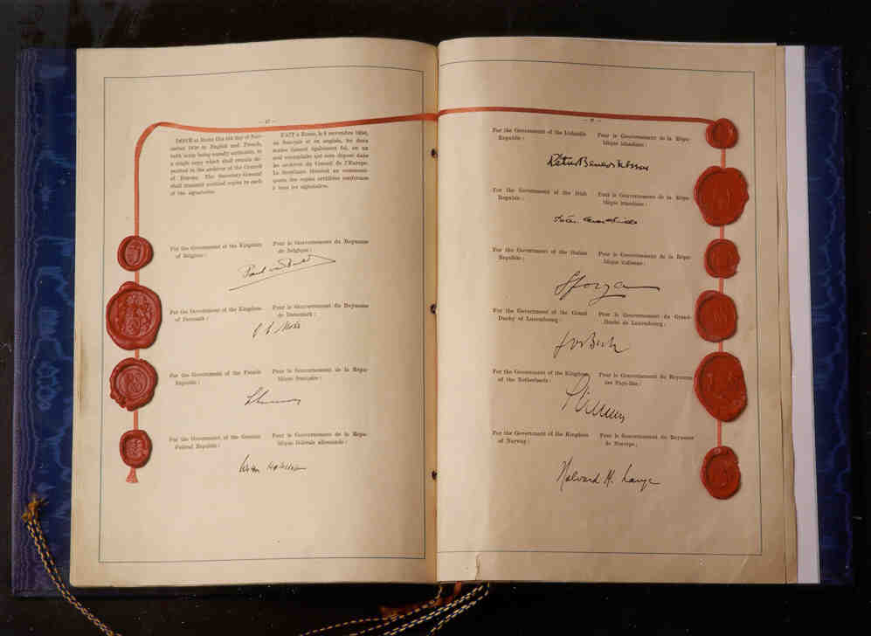
Incompatibility ratione materiae
For a complaint to be compatible ratione materiae with the Convention, the right relied on by the applicant must be protected by the Convention and the Protocols thereto that have come into force.
Important notions: „civil rights and obligations”, „criminal charge” in Art. 6., „private life”, family life”, „home” and „correspondence” in Art. 8, „possessions” in Art. 1 of Protocol No. 1.
Usually, the Court gives autonomous, broad meaning to these terms.

Slide 24
Inadmissibility based on the merits
A. Manifestly ill-founded
B. No significant disadvantage
Any application will be considered “manifestly ill-founded” if a preliminary examination of its substance does not disclose any appearance of a violation of the rights guaranteed by the Convention, with the result that it can be declared inadmissible at the outset without proceeding to a formal examination on the merits (which would normally result in a judgment). This is done by a single judge or a three judge committee.
Examples: the ECHR is not a „fourth instance” court - it is not a court of appeal or a court which can quash rulings given by the courts in the States Parties to the Convention or retry cases heard by them, nor can it re-examine cases in the same way as a Supreme Court.
Examples: there is a clear and apparent absence of a violation. This can mean that there is no: appearance of arbitrariness or unfairness, appearance of a lack of proportionality between the aims and the means.
Examples: The complaint is unsubstantiated because of lack of evidence.
Examples: the complaint is confused or it is far-fetched.

Slide 25
No significant disadvantage
Article 35 § 3 (b) is composed of three distinct elements. Firstly, the admissibility criterion itself: the Court may declare inadmissible any individual application where the applicant has suffered no significant disadvantage.
Next come two safeguard clauses. Firstly, the Court may not declare such an application inadmissible where respect for human rights requires an examination of the application on the merits.
Secondly, no case may be rejected under this new criterion (since 2014) which has not been duly considered by a domestic authority.

Slide 26
Significant disadvantage
“Significant disadvantage” hinges on the idea that a violation of a right, however real from a purely legal point of view, should attain a minimum level of severity to warrant consideration by an international court. Violations which are purely technical and insignificant outside a formalistic framework do not merit European supervision (Shefer v. Russia (dec.)).
Examples of disadvantages: financial disadvantage, non-financial disadvantage.

Slide 27
Safeguard clauses
Once the Court has determined that no significant disadvantage has been caused, it should proceed to check whether one of the two safeguard clauses contained in Article 35 § 3 (b) would nevertheless oblige it to consider the complaint on the merits.
It must examine: whether respect for human rights requires an examination of the case on the merits or whether the case has been duly considered by a domestic tribunal.

Slide 28
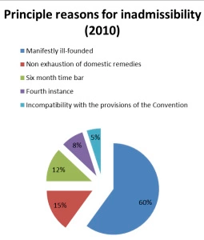

Slide 29
Literature used
This presentation is based on the „PRACTICAL GUIDE ON ADMISSIBILITY CRITERIA” which is available on: http://www.echr.coe.int/Documents/Admissibility_guide_ENG.pdf

