Slide 1
The Historical Development of Law

Slide 2
Revision

Slide 3
Complete the following statements:
A State is a territorial division in which a community of people lives subject to a _____________________.
The United Kingdom is a _____________ state.
Internal law is the law of a state regulating its ______________.
International law is a body of rules that regulates relations between __________ and rights and duties of _____________ in their relations to foreign states and with each other.

Slide 4
Match the branch of law and the matter it regulates:
Branch of law | The matter it regulates
Law of contract | family matters, such as marriage, divorce and custody of the children
Law of torts | Formation of companies and formal rules for running companies
Administrative law | income and taxes
Constitutional law | disputes between individuals
Revenue law | the powers of the executive organs of the state
Criminal law | the interpretation and construction of constitutions
Civil law | behaviour that is considered to be harmful to society as a whole
Family law | contracts and their legal consequences
Company law | Civil wrongs, such as nuisance or negligence

Slide 5
Translate the following phrases:
to settle a case out of court
to sue the defendant/to prosecute the defandant
to decide on fact and law in a civil court
to enter judgment for the claimant
to award damages
to plead guilty/not guilty
to pass a sentence
a fine or a term of imprisonment
to acquit the defendant.

Slide 6
The historical development of law

Slide 7
Customary law and the first codifications
Before the advent of writing, laws existed only in the form of custom.
Custom - a usage or practice of the people, which, by common adoption and by long and unvarying habit, has become compulsory, and has acquired the force of a law with respect to the place or subject-matter to which it relates. (Black's Law Dictionary)

Slide 8
The code of Hammurabi
Among the first written codes was that of Hammurabi, king and creator of the Babylonian Empire, dating back to about 1760 BC. This is one of the earliest examples of a ruler proclaiming laws to his people so that they can know their rights and duties.
The Hammurabi code of laws, a collection of 282 rules, established standards for commercial interactions and set fines and punishments to meet the requirements of justice.
https://www.youtube.com/watch?v=oDALXORbtR4

Slide 9
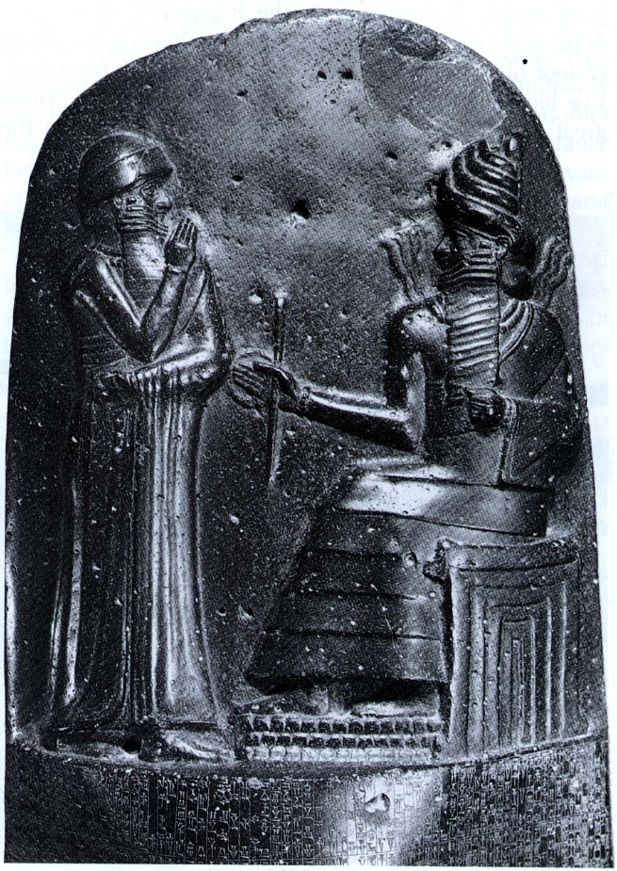
The diorite stele
A large stone about seven feet tall and two feet wide
At its top is a two-and-a-half-foot relief carving of a standing Hammurabi receiving the law—symbolized by a measuring rod and tape—from the seated Shamash, the Babylonian god of justice. The rest of the seven-foot-five-inch monument is covered with columns of chiseled script.

Slide 10
„An eye for an eye”
Hammurabi’s Code provides some of the earliest examples of the doctrine of “lex talionis,” or the laws of retribution, sometimes better known as “an eye for an eye.”
The Code of Hammurabi includes many harsh punishments, sometimes demanding the removal of the guilty party’s tongue, hands, breasts, eye or ear. But the code is also one of the earliest examples of an accused person being considered innocent until proven guilty.
The code explicitly mentions about 28 crimes that warrant death, including robbery, adultery and casting spells of witchcraft.

Slide 11
Examples of punishments
If a son should strike his father, his hands shall be cut off.
If a man put out the eye of another man, his eye shall be put out.
If any man should strike a man of higher rank, he shall receive sixty blows with an ox-whip.
If a builder builds a house for someone and that house collapses killing them, then the builder shall be put to death.

Slide 12
Solon
An outstanding example of early law-making may be found in the laws of the Athenian statesman Solon in the 6th century BC. Regarded by the ancient Greeks as one of the Seven Wise Men, he was granted the authority to legislate in order to assist Athens in overcoming its social and economic crisis.
https://www.youtube.com/watch?v=QtA6KCvsdLg

Slide 13
Roman law
Civil law or ius civile in its broadest sense was the law of the city of Rome.
In a narrower sense it refers to the secular law of Rome, private and public, to the exclusion of sacred law
Marked by the Law of Twelve Tables (the beginning) and Justinian’s codification

Slide 15
The Law of the Twelve Tables
Historians seem to agree that early classical Roman law was customary.
One of the earliest known codes of laws, the Law of the Twelve tables (c. 450 BC) consisted mainly of Roman custom with certain borrowings from Greek law. This was a collection of basic rules, rather than a comprehensive piece of legislation, yet it came to be regarded as the starting point of the Roman legal history.
https://www.youtube.com/watch?v=clmPMqeQs_I

Slide 16
The Twelve Tables were written by the Decemviri Consulari Imperio Legibus Scribundis (the 10 Consuls), who were given unprecedented powers to draft the laws of the young Republic.
Originally ten laws were drafted; two later statutes were added prohibiting marriage between the classes and affirming the binding nature of customary law.

Slide 17
The new code promoted the organization of public prosecution of crimes and instituted a system whereby injured parties could seek just compensation in civil disputes.
The plebeians were protected from the legal abuses of the ruling patricians, especially in the enforcement of debts.
Serious punishments were levied for theft and the law gave male heads of families enormous social power (patria potestas).

Slide 18
Summons
The bringing of an action began with the plaintiff personally summoning the defendant to follow him before the magistrate.
The Twelve Tables contained detailed provisions governing this summons:
Table I: Preliminaries to a trial
1. If plaintiff summons defendant to court, he shall go. If he does not go, plaintiff shall call witness thereto. Then only shall he take defendant by force.
2. If defendant shirks or takes to heels, plaintiff shall lay hands on him.
3. If disease or age shall be an impediment, he shall grant him a team (for transport); he should not spread with cushions a covered carriage if he shall not so desire.

Slide 19
Importance
The important basic principle of a written legal code for Roman law was established , and justice was no longer based solely on the interpretation of judges.
These laws formed an important part of the foundation of all subsequent Western civil and criminal law.
The full text of the code has not survived, only some fragments

Slide 20
Classical jurists
During the period of the so-called classical jurists (Gaius, Ulpian, and others), between the 1st century BC and the middle of the 3rd century AD, Roman law achieved considerable sophistication.
After the collapse of the Western Roman Empire in 476 AD, the development of Roman law was disrupted in Western Europe.

Slide 21
Justinian’s codification
Between 529 and 534 AD, the Byzantine emperor Justinian ordered a systematic and comprehensive codification of laws.
https://www.youtube.com/watch?v=8Y2pAGcW51Y
The collection of laws and legal interpretation developed under Justinian’s sponsorship from 529 AD to 565 AD; it is commonly called Corpus Juris Civilis
It comprises four books (Digest, Codex, Institutes and Novellae)

Slide 22
The first European universities
Six hundred years after the collapse of the Western Roman Empire, the scholarly study of Roman law revived, starting in Bologna, the first university in Western Europe (c.1088 AD).
Between 1100 and 1500 universities spread all over Europe.

Slide 23
Reception of Roman law in Europe
Universities taught civil law and canon law (church law), both based on Roman law
The church had jurisdiction over marriage, wills and lawsuits between clerics
Civil law was studied and interpreted by scholars (glossators) and commentators (post-glossators) – Roman law as interpreted by them became the basis of ius commune (the common law of Europe)
England was an exception

Slide 24
National codifications
By the end of the 18th century the emergent nation states started creating their own national codes
The Napoleonic Code of 1804 – addressed to the average citizen of France; clear and understandable language
The German Code of 1900 – addressed to the legal profession – abstract and complex legal language

Slide 25
Common law
Traceable to Anglo-Saxon times and forms the basis of English law
It was formed from the customs of the people
Common law (the general law contained in decided cases; unwritten or judge-made law) means ancient customs, precedents and books of authority (writings of jurists)
Acquired in England early because it had a strong centralised monarchy before most other parts of Europe
William I – Henry II

Slide 26
William the Conqueror
The first legal system that became common to the whole country (England and Wales) after the Norman Conquest in 1066
William the Conqueror decided to set up a central system of government that would include the justice system
https://www.youtube.com/watch?v=tc92zC0P0Iw
Curia Regis – the King’s court

Slide 27
The King’s Court
The nobles who had a dispute were encouraged to apply to have the king or his judges decide the matter.
In addition to the central court, the judges were sent to major towns to decide any important cases. Thus judges travelled from London all around the country.

Slide 28
Henry II
Henry II (1133-1189) - Henry's reforms allowed the emergence of a body of common law to replace local customary laws and the disparate customs of feudal and county courts.
Under Henry II the royal courts extended their jurisdiction at the expense of local and feudal courts

Slide 29
Henry II divided up the country into 'circuits' or areas for the judges to visit. Similar cases were decided in similar ways, and decisions of royal judges were held in great esteem by local judges. Lower courts gradually became bound by decisions of higher courts.
Permanent courts were established at Westminster and in the counties, staffed by professional judges and judicial personnel selected largely on legal education, expertise and merit.
https://www.youtube.com/watch?v=cc_cLLBYQJg

Slide 30
Thank you for your attention!

