Slide 1
State Governance and Administration of Justice

Slide 2
Revision

Slide 3
Complete the following:
The system of codified law that prevails in continental Europe, South America, and elsewhere is known as _____________, in contrast to the _____________ system that applies in England, former British colonies, the United States, and most of Canada.

Slide 4
Match the collocations:
forbid | a will
make | a legal system
compensate | a sanction
create | conduct
determine | for injury

Slide 5
Answer the following questions:
What are the major sources of law?
How would you define case law?
How can we define a precedent?
What do civil law systems rely on?

Slide 6
Translate the following:
repeal a rule
statutory law
case law
civil law countries
binding decision
applicable principles

Slide 7
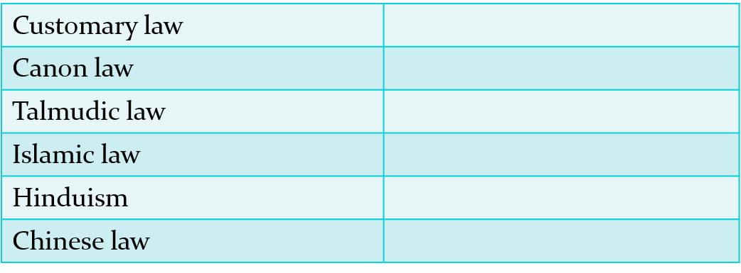
Other legal traditions
Read the text and complete the table providing basic information about each of the legal traditions:

Slide 8
Part One: Separation of Powers

Slide 9
John Locke
John Locke (1632-1704) studied the bloody civil wars in 17th-century England, and concluded that what was needed was a division among political institutions. It was a mistake to entrust government functions to a single department: it may be too great a temptation to seize power, for the same persons who have the power to make laws to have also in their hands the power to execute them.

Slide 10
Separation of powers
The great political philosopher Montesquieu coined the phrase the ‘separation of powers’ in the 18th century
“Government should be set so that no man need be afraid of another”
Three individual elements of the state:
the executive, the legislature and the judiciary
Three branches of power:
the executive, the legislative and the judicial branch

Slide 11
Elements of the state
The executive: Government (Government executes the law)
The legislative: Parliament as the highest legislative body (Parliament makes the law)
The judiciary: the system of courts (courts enforce, apply and interpret the law)
https://www.youtube.com/watch?v=BXXv3QrH4qs

Slide 12
The doctrine of the separation of powers
According to the doctrine of the separation of powers, each branch of government has different functions but each uses its power to control the limits of the others. Conversely, within the limits of its powers, each branch should be independent of the others.

Slide 13
The legislative branch
carried out by a legislature, which may bear a name such as parliament or assembly;
a legislature typically consists of a varying number of representatives elected by the citizens of the state.
unicameral or bicameral legislatures, i.e. one or two legislative chambers. The lower chamber is commonly the directly elected one, while the upper chamber may be elected by the lower, it may represent different administrative or geographical regions of the state, or have an entirely different setup.

Slide 14
Principal tasks of the legislative branch
enacting law by examining and debating legislative proposals (put forward by the executive branch, individuals or special interest groups) and finally approving them (voting)
approving the state budget and taxation
controlling (scrutinizing) the work of the executive branch.

Slide 15
The executive branch
The executive branch is the one that directly governs the country. It carries out this task by designing and implementing policies in the various areas of life of a state.
The executive draws up and implements development strategies, which involve allocating state budget funds to certain activities.
The highest executive body in terms of power is usually a group of persons known collectively as the government in the narrow sense – a number of ministers headed by the prime minister

Slide 16
Government
Government - a body which exercises the executive powers in conformity with the Constitution and law
“The Government shall pass decrees, introduce legislation, propose the state budget, decide in cases of conflict of jurisdiction between government institutions, give answers to representatives’ questions and adopt strategies of economic and social development.”

Slide 17
The judicial branch
The judicial power is embodied in the system of courts
Hierarchy of courts; the Supreme Court as the last instance for appeals within the national court system
This branch enforces the law in court and it must be independent from the other two branches
Judges are often prohibited from engaging in political activity as their impartiality in adjudication is a prerequisite for fair and consistent application of the law.

Slide 18
Judicial appointments
Unlike the legislative and executive branches, the judicial branch is not usually subject to elections by the people, although it is not uncommon for judicial appointments for higher courts to be subject to approval by the legislature.

Slide 19
Checks and balances
A government in which no person or branch of government could become all-powerful
Powers are divided among the legislative, executive and judicial branches of government
Even though the powers may seem to be distinct and perfectly separate, in most systems they overlap
Each group can balance and check other’s powers

Slide 20
Decide whether the following statements are true (T) or false (F). If false, provide the correct information.
1. The legislative branch enforces the law.
3. Parliaments create strategies and development projects.
4. The Government proposes laws to Parliament, which has the final word in their enactment.
5. Citizens cast their vote in elections and choose the Prime Minister.
6. Judicial appointments are sometimes confirmed by Parliaments.
7. Parliaments typically confirm international treaties so that they can become law of the state.
8. The executive has no law-making power whatsoever.
9. The Cabinet can abolish laws made by Parliament.

Slide 21
Match the verbs in the left column with the nouns in the right column. Multiple matches may be possible for each verb.
1. apply | a. (a, the) law
2. confirm | b. a decision
3. devise | c. a judicial appointment
4. enact | d. a legislative proposal
5. enforce | e. an order
6. implement | f. a policy
7. invalidate | g. a strategy
8. propose | h. a treaty
9. put forward | i. the members of the government
10. ratify | j. the state budget

Slide 22
Answer key
apply a/the law
confirm a judicial appointment, the members of the government, the state budget
devise a policy, a strategy
enact a law
enforce a/the law, a decision, a policy, a treaty
implement a policy, a strategy
invalidate a decision
propose a law
put forward a legislative proposal
ratify a treaty

Slide 23
Decide which branch does the activities from the previous exercise and list them under the appropriate headings. Some activities can be sorted under multiple headings.
EXECUTIVE | LEGISLATIVE | JUDICIAL

Slide 24
Rewrite the following sentences replacing the underlined expressions with expressions from the text.
1. The law-making body makes laws that all citizens must act in accordance with.
2. The Croatian Parliament is a one-chamber legislature.
3. Parliaments examine closely and critically the work of the executive.
4. Presidents or other representatives can sign international agreements, but they are normally confirmed by the legislative body.
5. The government in the narrow sense consists of heads of government departments.
6. State budget funds are distributed to development projects that are planned to be put into practice.
7. Judicial independence in making decisions in disputes is of the highest importance.
8. Some courts can abolish laws or parts thereof.

Slide 25
Complete the chart with appropriate word forms:
NOUN | VERB
 | enact
enforcement
 | scrutinize
abolition, abolishment
 | ratify
 | propose
appeal

Slide 26
Part Two: Resolving Disputes

Slide 27
Administering justice
The judicial branch of government administers justice within a number of systems, depending on the type of dispute.
The principal line is drawn between the civil and criminal law, which is enforced through a system of civil and criminal courts respectively.

Slide 28
Prosecutor v. claimant
While in criminal law the prosecutor (the state) seeks to punish a criminal offender, civil justice deals with resolving conflicts or disputes between natural and legal persons concerning their private interests. Such proceedings are initiated by the claimant and generally do not involve the public interest.

Slide 29
Civil justice
Civil justice includes family justice, administrative, civil, and commercial justice systems.
The family justice system is set up to help individuals resolve matters such as divorce, child custody, etc.
Administrative justice deals with administrative disputes initiated by natural or legal persons concerning decisions reached in administrative procedures by state authorities, such as building permits, tax ordinances, or licences to practice a profession.
Strictly civil justice concerns various disputes between individuals or legal entities regarding harm, breach of contract, product liability, etc.
Disputes between and/or concerning business organisations and commercial activities fall within the domain of commercial law.

Slide 30
ADR
Resolving a case in court is subject to strict and detailed procedural rules. It usually entails considerable costs of litigation (court and lawyer’s fees), and tends to be time-consuming.
As an alternative to litigation, where a court adjudicates and enforces a solution, a number of alternative dispute resolution formats (ADR) have developed in order to achieve dispute resolution in a more collaborative way.

Slide 31
If consumers have a complaint about a good or service they have bought, instead of going to court, they can choose Alternative Dispute Resolution (ADR).
The term ADR includes all the ways of resolving a complaint which do not involve going to court.
Typically consumers ask a neutral third party to act as an intermediary between them and the trader; this neutral third party is called an ADR entity.

Slide 32
The ADR entity can then suggest or impose a solution, or simply bring the two together to discuss how to find a solution.
This is also known as “mediation”, “conciliation”, “arbitration”, “ombudsman” or “complaints’ board”.

Slide 33
Read the text about ADR (pp. 46-47) and find words/expressions that mean the same as the following:
1. go-between (n.) _____________________
2. conducted _____________________
3. inform _____________________
4. resolve (a dispute) _____________________
5. ask for reparation _____________________
6. resulting (from) _____________________

Slide 34
Thank you for your attention!

