Slide 1
PROTECTION OF ENVIRONMENT THROUGH CRIMINAL LAW
Criminal Law of the EU
Harmonization of Substantive Criminal Law
By Valeriia Biriukova

Slide 2
DIRECTIVE 2008/99/EC ON THE PROTECTION OF THE ENVIRONMENT THROUGH CRIMINAL LAW
Reasons:
rise in environmental offences and their effects
spread beyond the borders of a State where the offence had been committed
administrative and compensatory civil measures are not sufficient
particular need for serious penalties for environmentally harmful activities: damage to air, soil, water, animals, plants.
Goals:
effective protection of the environment
common rules
use of effective methods of investigation and assistance within and between MS.

Slide 3
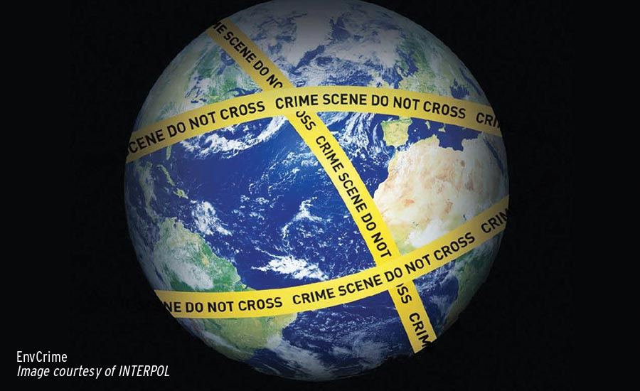
OFFENCES
Discharge, emission, introduction of material/ionising radiation into air, soil, water
Collection, transport, recovery, disposal, shipment of waste
Operation of a plant with dangerous activity/substances
Production, processing, use, storage, transport of nuclear materials/ozone depleting materials
Killing, destruction, possession of specimens of protected wild fauna/flora
Any activity leading to deterioration within a protected site.

Slide 4
APPLICATION & TRANSPOSITION OF THE ENVIRONMENTAL CRIME DIRECTIVE
Indirect effect
Recognition of inciting, aiding, abetting as criminal offence
Liability of legal persons (if committed for their benefit)
Effective, proportionate, dissuasive sanctions
Transposition in national legislation before 26 December 2010 (Croatia: 1 July 2013)
Different number of measures taken: 1 in France, 114 in Belgium, 15 in Czech Republic, 286 in UK
Cases: illegal export of e-waste from EU to China, “Land of fires” in South Italy (waste mafia), illegal wildlife trade in UK and Norway.

Slide 5
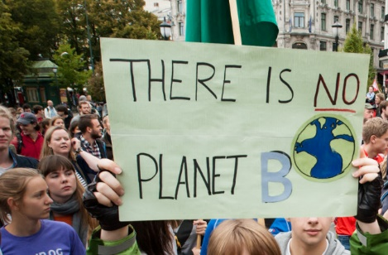
CONCLUSION
Legal basis – Environmental crime Directive + national transposition (Criminal Code, Public Health Regulations)
Serious criminal matter: impact on health, ecosystems, links to organized crime
Personal responsibility.

Slide 6
Thank you for your attention!
Questions are more than welcome :)

