Slide 1
LEGAL SYSTEMS OF THE WORLD
Unit 5

Slide 2
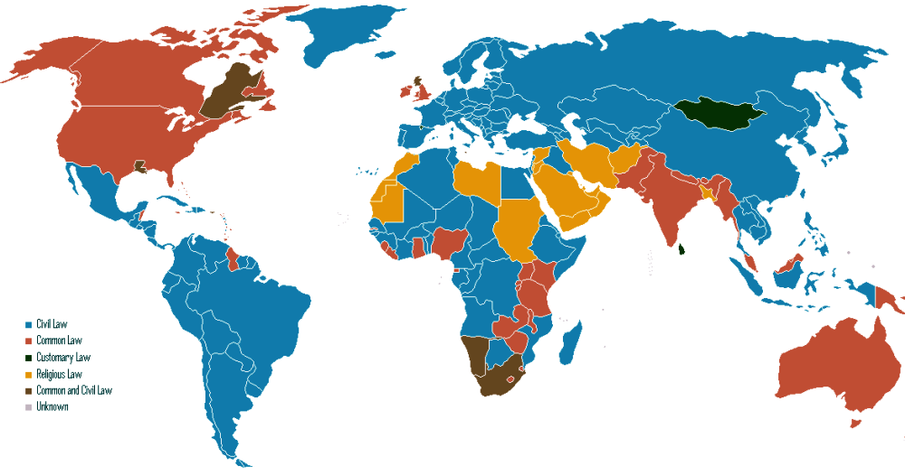
The legal systems of the world

Slide 3
Five factors creating a legal system
Read the text, p. 33 and complete the list:
1. Rules forbidding ________________________
2. Rules requiring _________________________
3. Rules stating ___________________________
4. A system of courts with the task to_____________
_______________________________________
5. A law-making body with the power to ___________
________________________________________

Slide 4
National legal systems
Read the text, p. 33 (passage two) and complete the definition:
A legal system is being developed in the context of a single ____________. Legal systems can be organized on the basis of ___________________, ____________ and ____________________.
Statutory law, religious law, c___________ and c______ law can have a very different impact on each legal system.
Examples of bigger legal systems are: civil ____________,
______________ common law systems, Islamic_______, ________ law, etc.

Slide 5
Classification of legal systems
Read the text, p. 33 - 34 (passage two) and complete the three criteria for the classification
1. The first group of elements include….
2. The second group of elements consists of…..
3. The third group of characteristics is related to….

Slide 6
Major legal families
Read the text, p. 34 and complete the table:
Features and territories
CIVIL LAW | COMMON LAW
Based on Roman law Systematic and comprehensive codifications General concepts used in solving individual problems Influenced by the French legal tradition + German legal tradition Territories: primarily states on the European continent | Basically no codes major importance of decisions of judges - - - - Territories: England, USA, Canada, former British colonies

Slide 7
What is a precedent? – key concept of the common law system
A precedent is…
an example to be followed: thus, a previous decision by a superior court on similar facts; or a draft of a legal document which serves as a pattern in future.
to set / create a precedent: to make a decision in court which will show other courts how to act in future
to follow a precedent: to decide in the same way as an earlier decision in the similar type of case

Slide 8
Types of precedent
two types of precedent: binding precedents and persuasive
Type I
A binding precedent obliges a court to follow its decision
Type II
- a persuasive precedent can influence a decision but not compel or restrict it
- Decision of a lower court

Slide 9
Read the text, p. 35, exercise V
After reading the text sort once again the main features of common law and of civil law in the table, in the exercise VI.
Do the exercise VII, p. 36

Slide 10
Part II – Other Legal Traditions
Read the text, p. 37 – 38 and add the legal tradition for each of the given descriptions.
Legal tradition | Main characteristics - description
 | One of the oldest legal traditions; important for Jewish people; significantly influenced the Western commercial, civil, and criminal law
 | Includes a set of culturally and socially appreciated norms – the concept of „li”, idea of citizens being willing to contribute to social order instead of laws
 | Shari’a is the name for that legal tradition that relies on earthly lawmaker, based on the teaching of Koran, it does on the will of the Almighty (Allah)
 | Based on the works of scholars and linked to the Vedas, which contained systematic descriptions of customary law applied in India; changed after British colonization
 | Still has an important role, especially in jurisdictions with mixed legal systems
 | This tradition has been associated with the Roman Catholic Church for the longest time in the Western world, however, separation between church and state is present in the West. Possible is also the co-existence of church law and state law as well as adoption of church law as state law.

Slide 11
Confucius’ li-based theory v. legalism
Read the last text paragraph, p. 38 and explain
The view of Confucius as opposed to the view of those who support legalism.
When the Qin Dynasty came to power in 221 BC, it found itself ruling over a land where the teachings of Confucius had been spreading for almost 300 years. Qin attempted to rule China using a new philosophy, that of
Legalism

