Slide 1
Cyber-crimes: Between Reality and perspectives
Lebanese practical situation
Dr Janane KHOURY – Lebanon
Cell. +961 3 81 88 29
E-mail: janane.khoury@hotmail.com

Slide 2
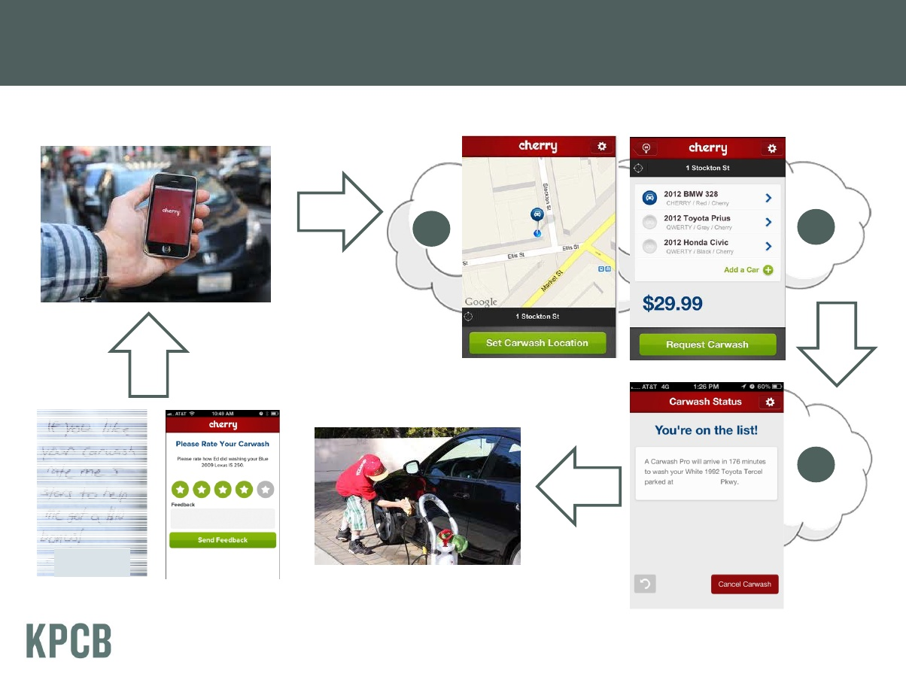
From hand to cloud

Slide 3
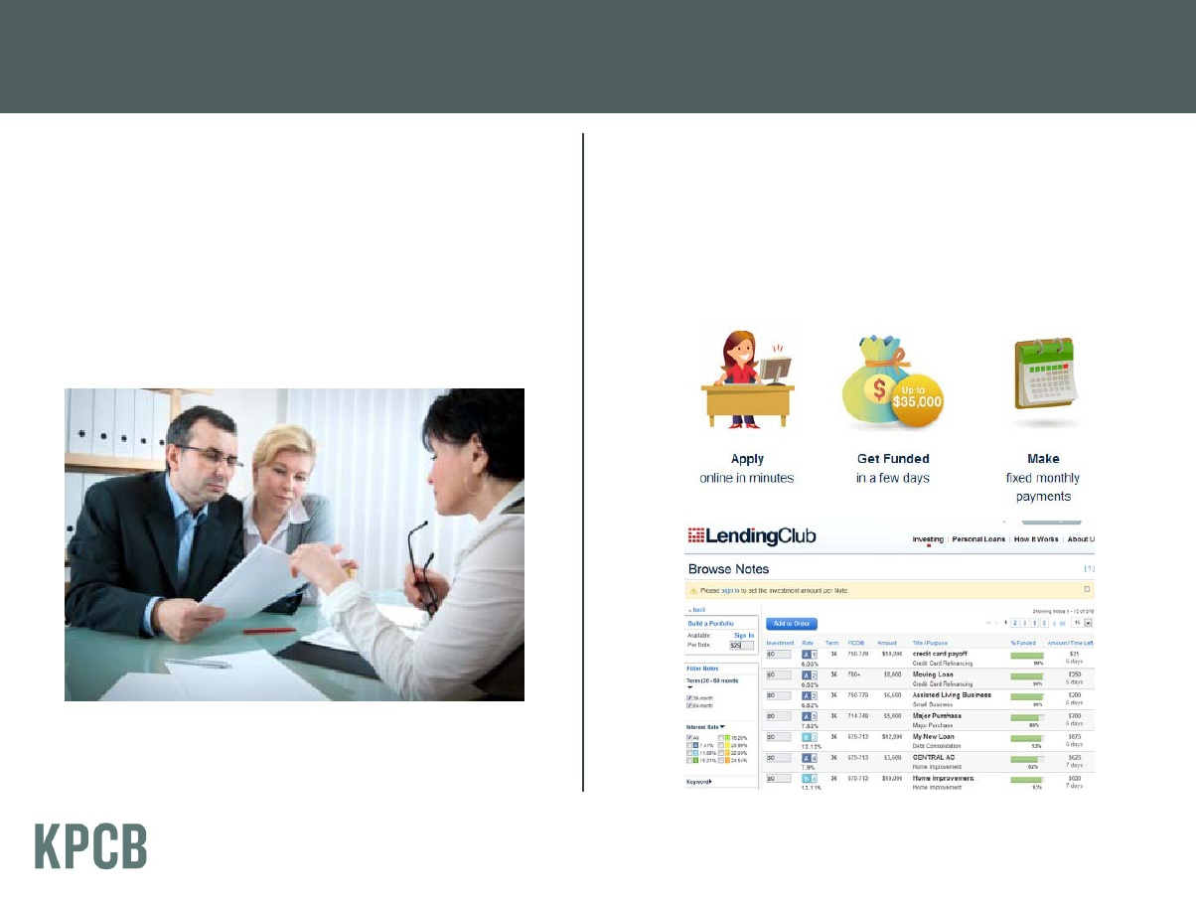
Borrowing lending money

Slide 4
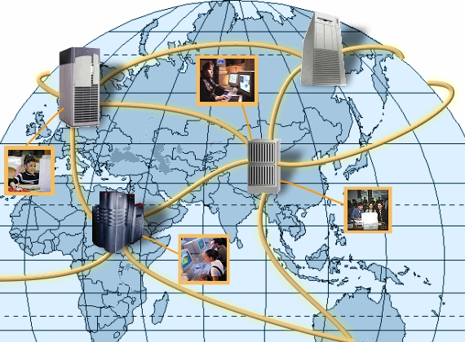

Slide 5
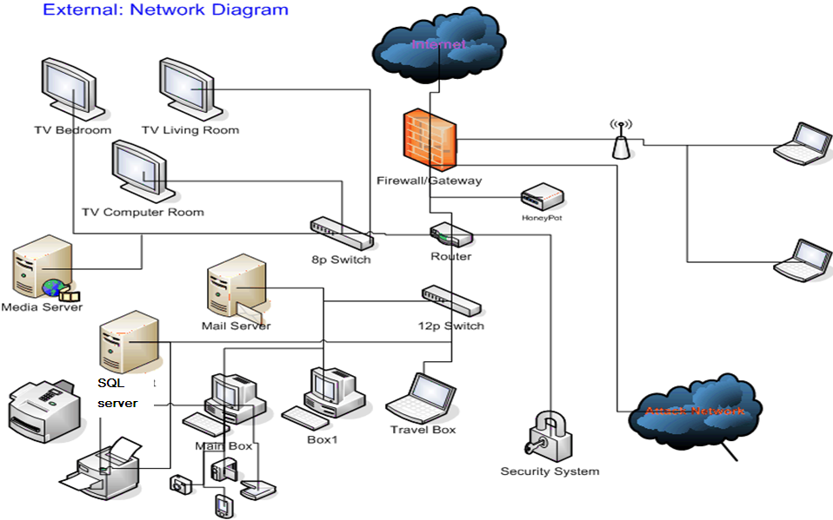
ومن صفات الجريمة الإلكترونية :

Slide 6
INTRODUCTION
To decide to undertake an academic study on the current field situation of the Cyber-crimes in Lebanon is a very difficult task for many reasons, objective, procedural, operational and conceptual.
But to decide to set proposals to be adopted at the local level in order to prevent long-term risks from becoming imminent ones and for the imminent risks not to become a threat to public order and public safety is something worthy of serious consideration.

Slide 7
It is known that Lebanon (us all Countries) is witnessing a new world order, the global civil society or “global village”, which is different in most of its aspects from the order we have known since World War II;
however, while all countries of the world – including Lebanon – have been busy consolidating this global order, they did not notice that they might be the victims (in some manners) of this globalization.

Slide 8
In fact, countries, are facing these days a criminal phenomenon that has a spatial transnational dimension geographically as well as politically, particularly cyber-crimes, transnational organized crimes and the international economic crimes (money Laundering, cyber-crimes…).

Slide 9
This was due to the changes that occurred in the socio-cultural and economic structure which became global instead of being local – and “globalization”;
This generated new behaviors, deviant and criminal, and this is no longer a national phenomenon, it is rather a global one. In short, we can say that the majority of crimes is no longer local or international; there is now something that is called “globalization of crime”.

Slide 10
This puts the realm of national laws in front of huge changes represented in the growing challenging of the national Law that has evolved throughout the centuries, while the geographical and spatial national borders opened in just a few years.

Slide 11
One of the main pillars of modern society is the capacity to recognize and repress the crime, and this is a right and a duty for each state as well as the essence of its existence.
It preserves public order and public interest, so individuals are less concerned about their lives, freedoms and property;
does the State assume its role nowadays?
Is a return to the objective and procedural legal rules in force against transnational crimes a sufficient task?
Especially as preparation, planning, execution, hiding or concealment usually takes place in a specific country or even on a certain continent, which scatters evidence…

Slide 12
the main characteristic of such crimes is:
that they occur and they are not uncovered,
and if they are uncovered their author is not found,
and if the author is found there is not sufficient evidence to indict him.
In other words, has the national law been globalized to keep on with its function that is represented in expressing the public conscience and protecting society?
Practically, can the national law be globalized just like the global economy?

Slide 13
New technology and new form of crimes:
Such crimes are not individual ones, they are new and complex universal collective crimes, they can also be economic, organized, mafia-like, terrorist, transnational, supranational, as well as technical and banking crimes.
it is worth mentioning here, that the technology developments made it possible to commit traditional forms of crime in new ways:

Slide 14
Cross Border organized crimes
Terrorist crimes (Cyber-crimes)
Corruption
Trafficking in persons
Trafficking of prohibited or monopolized goods
  Smuggling of migrants
  Drug trafficking
  Arm trafficking
Money Laundering
Environmental crimes (pollution)

Slide 15
Types of cybercrime
Hacking of computer systems and networks
Cyber pornography involving production and distribution of pornographic material, including child pornography
Financial crimes such as siphoning of money from banks, credit card frauds, money laundering
Online Gambling
Intellectual property crimes such as theft of computer source code, software piracy, copyright infringement, trademark violations
THREATENING Harassments such as cyber stalking, cyber defamation, indecent and abusing mails
Cyber frauds such as forgery of documents including currency and any other documents
Launching of virus, worms and Trojans and PHISHING
Denial-of-service attacks
Cyber attacks and cyber terrorism SALAMI ATTACK
Economic espionage
Consumer harassment and consumer protection
Privacy of citizens
Sale of illegal articles such as narcotics, weapons, wildlife,
VIRUS DISSEMINATION
IRC Crime
NET EXTORTION
SPOOFING

Slide 16
2. Methods of Attack from Organized Hackers
Hacking in simple terms means illegal intrusion into a computer system without the permission of the computer
A. Mass SQL Injection
B. Malicious Code Attack from USB Drive
C. Social Engineering Email Attack

Slide 17






A. Mass SQL Injection
Level 3: Downloading Malicious Codes or Backdoor Trojans from Landing Sites
Level 2:
Websites Attacked
Level 1:
Attacks Initiated
Introducing Websites for Malicious Codes Downloading
9i5t
Attacking Users or Planting Trojans.
Hackers
Linking One of the Websites by Users
Pilfering
Personal Information
Scanning for Injection
Points
Planting Massive Malicious Links
Level 4:
Gathering Information by Trojans
Notes:
First automatic cyber attack caused by Mass SQL Injection took place on May 19, 2008. Different from previous attacks, hackers launched massive attacks through multi-computers at web servers which applied MS SQL server.
First automatic cyber attack caused by Mass SQL Injection took place on May 19, 2008. Different from previous attacks, hackers launched massive attacks through multi-computers at web servers which applied MS SQL server.
First automatic cyber attack caused by Mass SQL Injection took place on May 19, 2008. Different from previous attacks, hackers launched massive attacks through multi-computers at web servers which applied MS SQL server.
First automatic cyber attack caused by Mass SQL Injection took place on May 19, 2008. Different from previous attacks, hackers launched massive attacks through multi-computers at web servers which applied MS SQL server.
First automatic cyber attack caused by Mass SQL Injection took place on May 19, 2008. Different from previous attacks, hackers launched massive attacks through multi-computers at web servers which applied MS SQL server.
First automatic cyber attack caused by Mass SQL Injection took place on May 19, 2008. Different from previous attacks, hackers launched massive attacks through multi-computers at web servers which applied MS SQL server.
First automatic cyber attack caused by Mass SQL Injection took place on May 19, 2008. Different from previous attacks, hackers launched massive attacks through multi-computers at web servers which applied MS SQL server.
First automatic cyber attack caused by Mass SQL Injection took place on May 19, 2008. Different from previous attacks, hackers launched massive attacks through multi-computers at web servers which applied MS SQL server.
First automatic cyber attack caused by Mass SQL Injection took place on May 19, 2008. Different from previous attacks, hackers launched massive attacks through multi-computers at web servers which applied MS SQL server.
First automatic cyber attack caused by Mass SQL Injection took place on May 19, 2008. Different from previous attacks, hackers launched massive attacks through multi-computers at web servers which applied MS SQL server.

Slide 18


3. Using BotNet to Control Victims and Stealing Data
Controlling Methods Often Seen
  By using relays and proxies to transmit linking messages in order to avoid detection
  Data stealing functions of the codes were decided and written by hackers
Controlling through the Use of MSN, IRC
Hard to tell the evil from good through the
same server
Victims
Relays
Hackers

Slide 19
Case Example of Cyber Intrusion Investigations (1)
On April 7, 2008, the MJIB received E-mails with malicious attachment files –’Corruption Enforcement.pdf’. Through analysis, the malicious code planted Trojan Horse in the computer right after the files being clicked. The computers were connected to a relay at port 80 of IP 211.20.97.38 (Situated in Hsin-Chu City) .

Slide 20
Case Example of Cyber Intrusion Investigations (2)
By tracing the connecting traffic at this relay on May 20, 2008, we found that hackers had already planted proxy relay programs in there. When connecting to this relay, hackers initiated another linking to the victimized computers with new malicious programs. These programs dynamically invited the hacked computers linking to another relays and uploading data.

Slide 21




Step 7: New Malicious Programs Creates Links to Another Relays and Uploads Data.
Step 9: Hackers Received Stolen Data
Step 1: Malicious Program Planted
Step 8: New Malicious Program Assigns Other Relays and Uploads Stolen Data. The Relays Include 1 IP in HK, 8 IPs in Korea, 3 IPs in Taiwan.
Step 6: New Malicious Program
New Malicious Program
Step 5: Receiving New Malicious Program
Computers Hacked
Step 4: Transmitting New Malicious Program
Hackers
Sources: Fu-Zieng Province, PRC (5 IPs)
broad.fz.fj.dynamic.163data.com.cn
Countries Hacked Includes：
TW(182)、CN(36)、 DE(15)、US(14)、CA(11) 、TH(8)、AE(6)、FR(5)、PE(3) 、JP(3)、PT(2)、AU、GB、KR…..
Step 2: Connection
Proxy
Step 3: Directing to Hackers
DE :Germany
AE :United Arab Emirates
PT :Portugal
PE :Peru
211.20.97.38 port 80
(Situated in Hsin-Chu County, Taiwan)

Slide 22
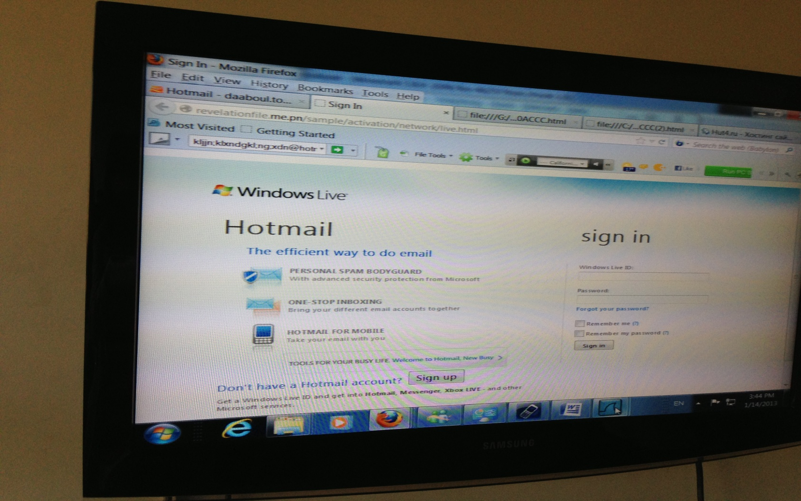
Current Case In CCIP Bureau

Slide 23
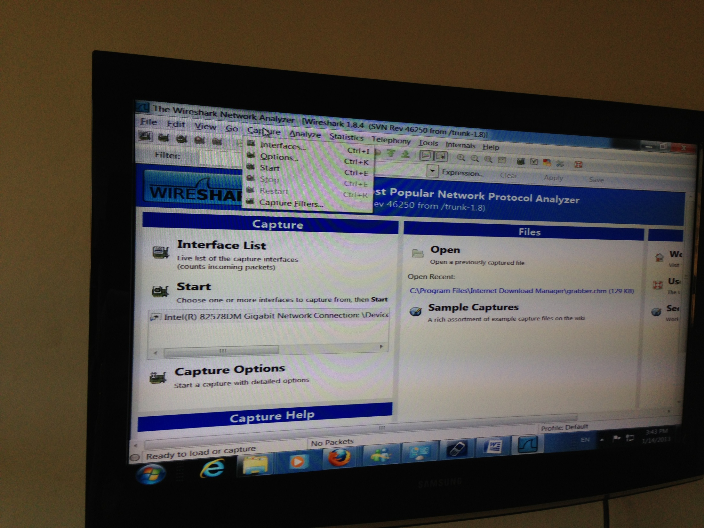

Slide 24
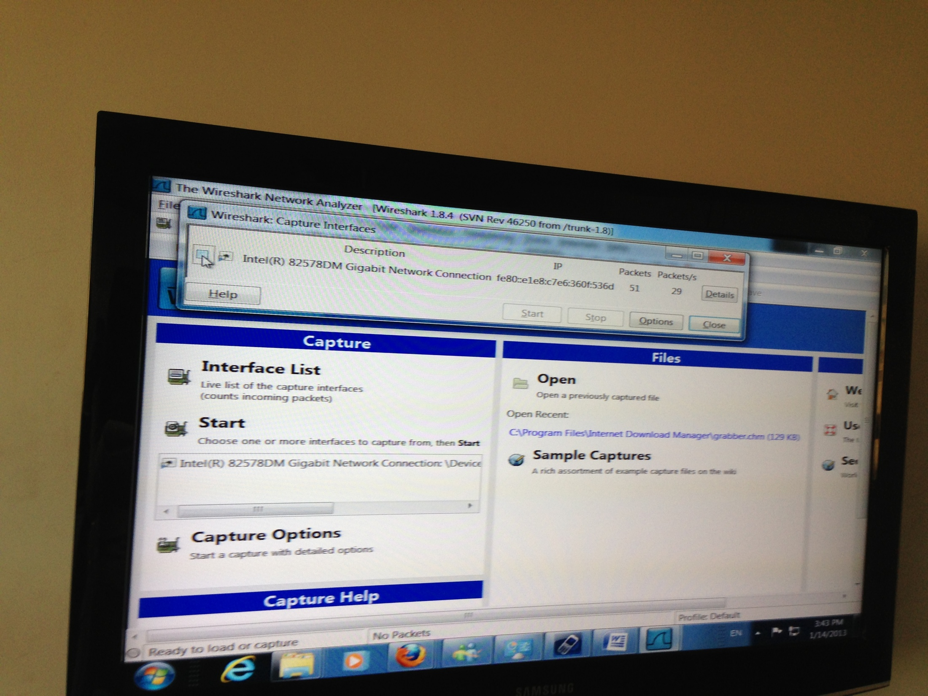

Slide 25
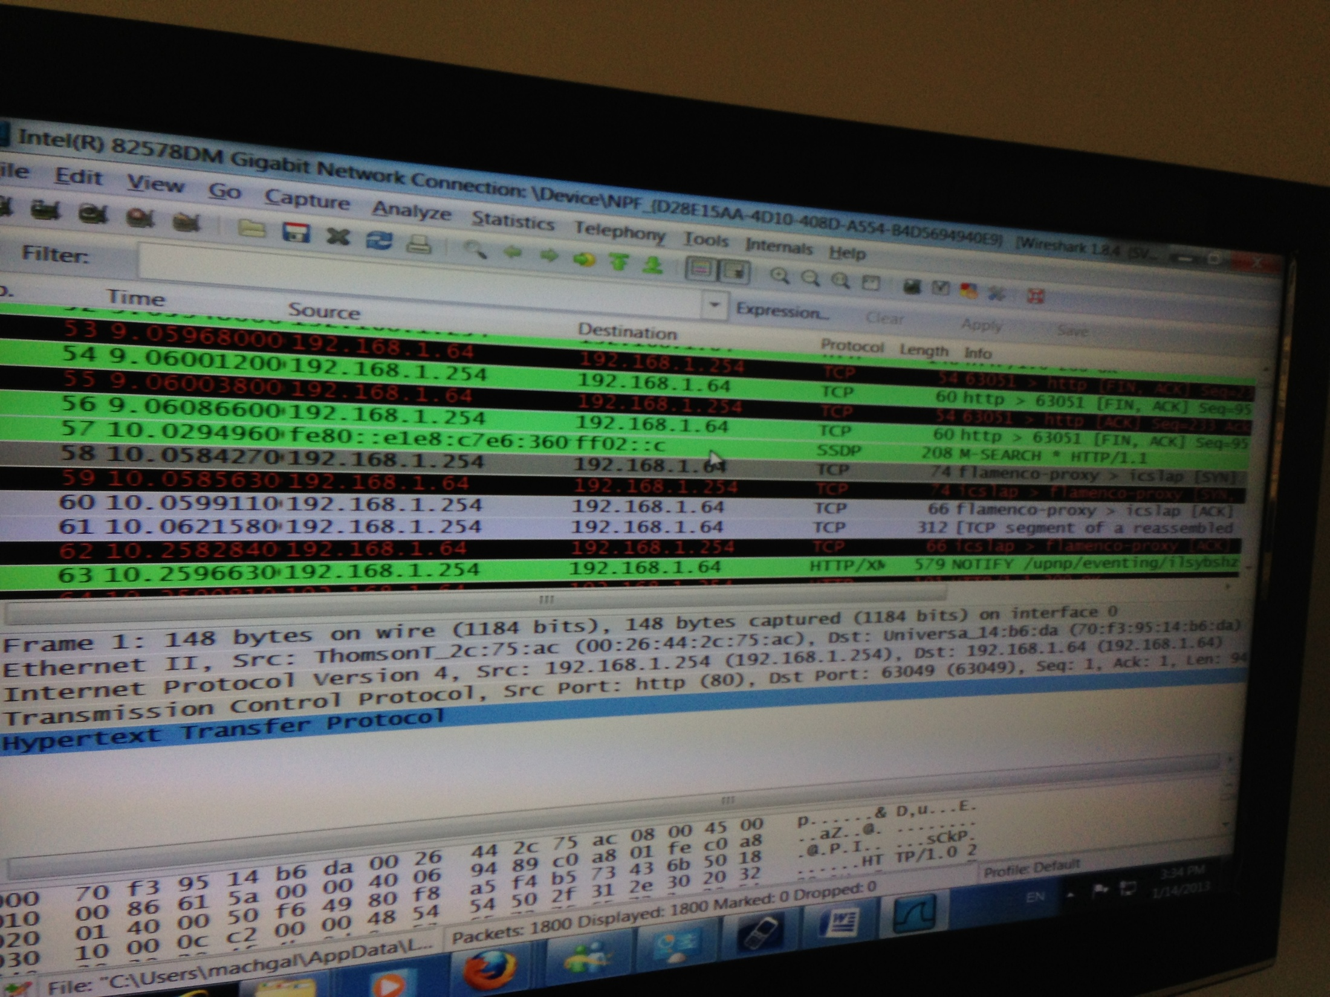

Slide 26
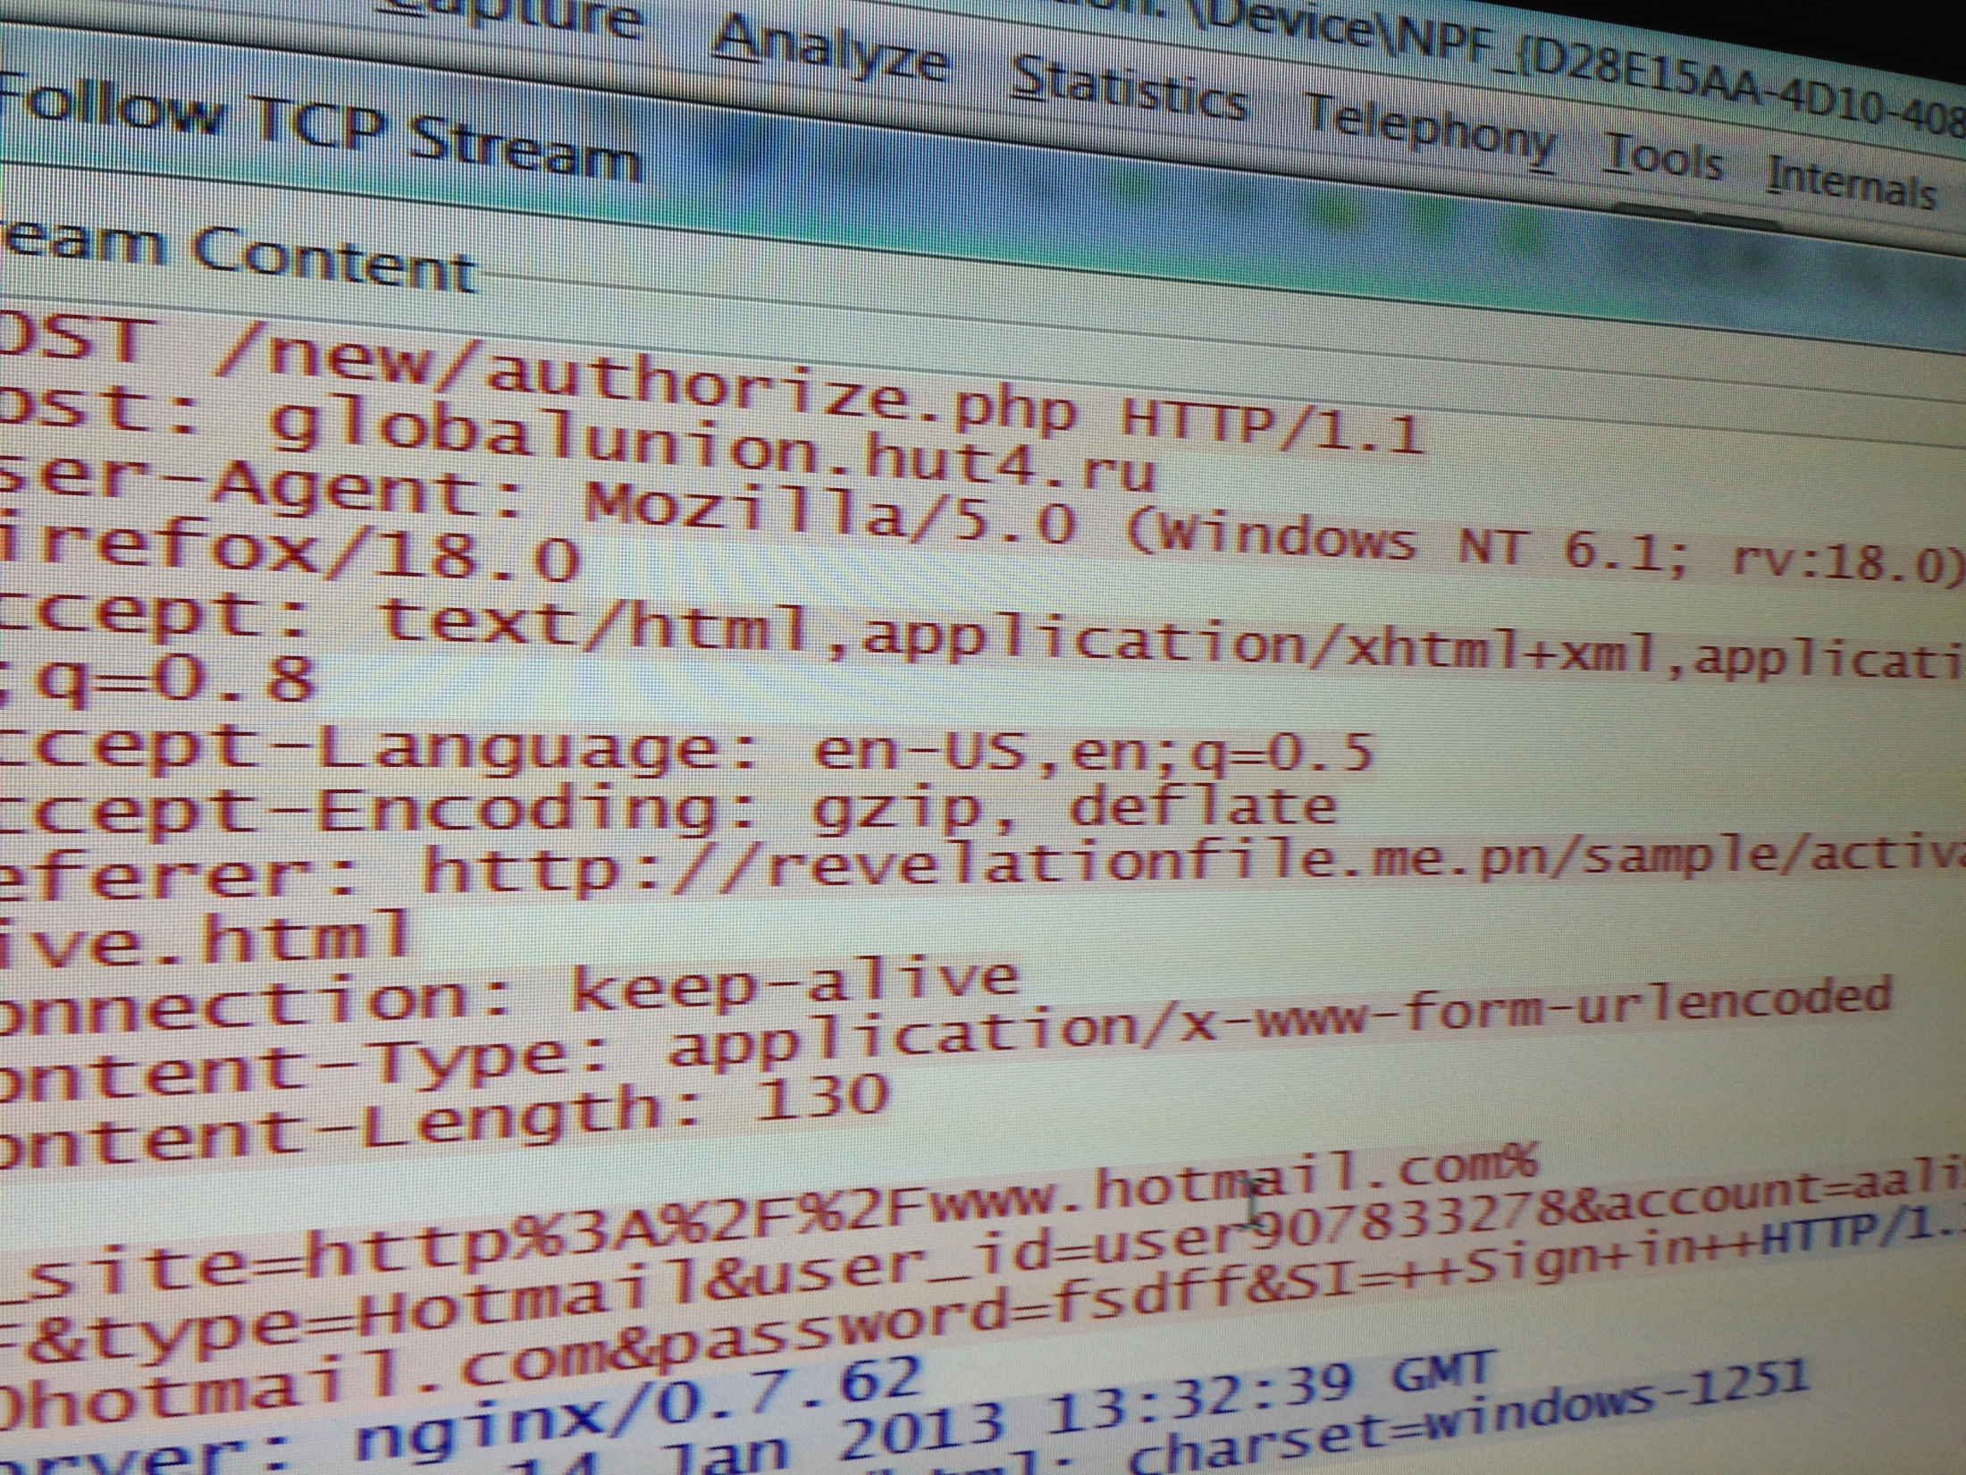

Slide 27
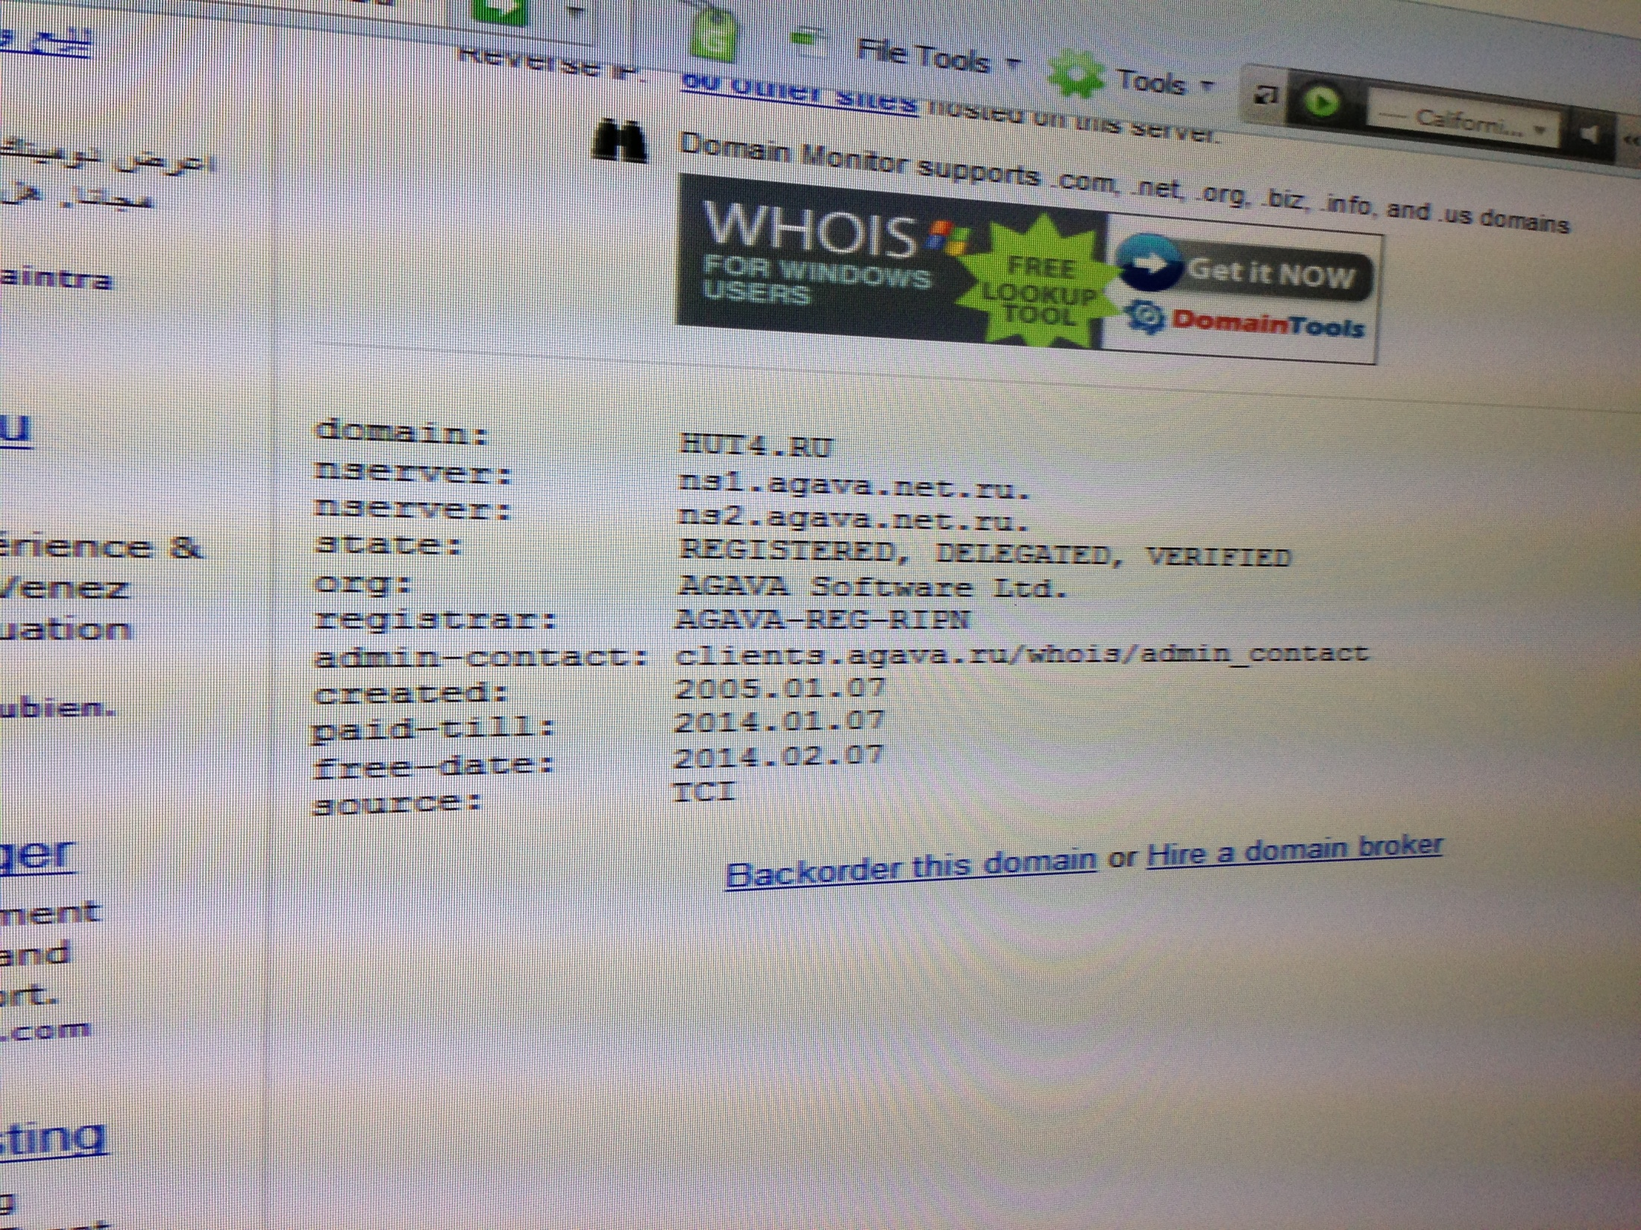

Slide 28
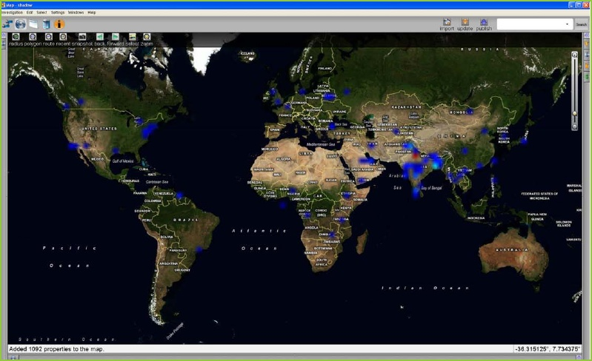
Geographical distribution of compromised hosts

Slide 29
Challenges on local level:
Many legal and practical problems lie behind these crimes and the cyber-crimes in local level, including:
In the concept and in fixing the responsibilities: this cyber-crime represents a challenge for the local criminal policy and for the Penal Code and procedure penal code...
The Lebanese law does not include -until now- any mention or interest in cyber-crimes.

Slide 30
On the field, the main obstacle is the absence of internal legislations and deterrents or any equipment for legal proceedings and investigations or even preventive measures.
It is thus worth noting that the expression “transnational organized crime” or “cyber-crimes” is still new to the Lebanese public opinion and even to the security and legal field…

Slide 31

An illustration of a man walking with a computer

Slide 32
Cyber-crimes and Money Laundering
The best place for hiding the proceeds of the criminal groups’ activities that are of criminal origin is no longer a house or a cave but they rather follow money laundering methods, breaching the domestic and international monetary laws through the internet using its confidential aspect, and benefiting from the available objection means as well as the absence of any electronic evidence adopted till now by the legislator.

Slide 33

Online Crime - Web Screen and Text

Slide 34

Online Crime Crossword

Slide 35

A montage of a credit card, dollar signs, a keyhole, a thief with ...

Slide 36
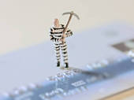
Credit Card Crime

Slide 37

Computer Hackers Using a Computer

Slide 38

Computer Hacker

Slide 39

Computer Hacker Looking at a Computer Screen and a Failure to Access ...

Slide 40

Cyber crime - Male hacker stealing information from laptop

Slide 41

Cyber crime - Male thief stealing information from laptop

Slide 42

Cyber Crime - Open Door to Computer Theft

Slide 43
it is worth mentioning here, that the technology developments made it possible to commit traditional forms of crime in new ways, Including:
fraud
the dissemination of child pornography,
and also to commit new forms of crime: such as hacking, spamming, “phishing” (using counterfeit websites (or messages directing users to them) for fraudulent purposes),
digital piracy,
malicious spreading of viruses and other attacks on critical information infrastructure.

Slide 44
Modern models for criminals:
the concept of criminality has always been limited to murder and theft, with no regard to professional activities or the white collar acts or people “of influence”…
In fact, criminals are no longer seen as people with mental deficiencies, or barbaric, illiterate, poor, socially deviant; they also include those who are physically fit, the degree holders, the rich and those who have high social positions…

Slide 45

Cyber Crime Eye

Slide 46
Criminals: mental structure:
If the criminal of the past used to rely on his organic structure, the criminal of today counts now on his mental structure;
if the former suffers (sometimes) from a mental deficiency or weakness or a mental disturbance, the latter enjoys full mental strength and even outsmarts others;

Slide 47
if the former had mental insanity the latter has megalomania.
There is worse an external factor than the unemployment of the poor for committing crimes;
it is the unemployment of the rich which pushes them to finance wrongful activities and with fraudulent means (trafficking of drugs…).

Slide 48
Victimology and cyber-crimes
The victim is no longer an individual, there are rather victims of multiple qualities and numbers:
man and human rights,
public ethics and their criteria,
the State and its national sovereignty,
the local laws and their principles,
the developing countries and their socio-economic development,
The stability of the local and international economic system, civilizations and their values,
the culture and its components…

Slide 49
- Poverty and criminality: A causal relationship
At the local level, a lot of development countries complain about the fact that the issue of “crime and development” is not being tackled and that the economic situation is not considered as part of the causes of criminal behavior.
The relation is clear between crime and poverty.
The individual economic situation and the economic society system play an important role in the constitution of criminal motives with the person who has the necessary readiness for such criminality, especially in the absence of a national strategy for an economic development that raises the socio-economic level of the individual and prepares job opportunities as an optimal means for preventing crimes…

Slide 50
Analysis shows the relationship between the quality of criminality and its prevalence on one hand and development on the other hand.
Remote marginalized areas in Lebanon are more exposed to criminality especially corruption, trafficking in human beings, drug use and dealing, smuggling of migrants, execution of crimes on the field, joining gangs…

Slide 51
Poverty is not more absence of income in those areas, it is a matter of absence of education too, of the possibility of political participation, decent work, security, lack of sufficient resources and inequality in development.
The main reason mentioned for this misery is ignorance, lack of awareness about individual and human rights and sometimes the indifference of states or leaders to the development of their populations. Which supposes that there is a need for the Lebanese citizen to be taken care of as a human being, including his education, liberation, promotion of his real humanity while he ceases committing non permitted or illegal acts to prevent the occurrence of crimes or reduce the chances of their occurrence… through the following strategies?

Slide 52
Such factors are the cause of misery of societies and corruption of governments as mentioned by the preamble of the Declaration of the Rights of Man and of the Citizen since 1789: “…believing that the ignorance, neglect or contempt of the rights of man are the sole cause of public calamities and of the corruption of governments…”

Slide 53
Preventive strategies
We can conclude from what preceded that there is an urgent need for following some preventive strategies in parallel with the drafting of laws to criminalize these activities, by excluding the bases for such crimes, i.e. an economic, social, cultural and intellectual integrated development.

Slide 54
Pursuit and investigation:
In terms of pursuit and investigation, there is a weakness and a lack of independence of the law enforcement agencies, especially that the criminal investigation powers in Lebanon and in all other development countries are limited, and many of these countries have outdated laws, or have no such laws at all, or suffer from corruption.

Slide 55
In addition to that, the members of the criminal groups outsmart sometimes the police officers.
They also have better means, technical equipment and sources of information.
They even constitute a big economic power with which they can have a financial control over the economies and policies of the states and even their legal systems and public safety.

Slide 56
In terms of international cooperation, the main obstacle lies in the absence of rapid and efficient practices for mutual extradition of criminals in many countries and the use by some criminals of some foreign countries as safe havens and places for hiding.

Slide 57
Consequently, in recognition of the need and advantages of having international cooperation and of the necessity to protect the citizens and their fundamental rights, and in view of helping put an end to, prevent and fight cross-border crimes efficiently

Slide 58
  Lebanon has ratified the UN Palermo Convention (Law No 680 of the 24/08/2005) after having signed it on the 18th of December 2001.
  But practically, the Lebanese legislator must take all legislative, objective, procedural and administrative measures necessary for good implementation of this convention due to the effective clauses it contains in terms of incrimination and prevention.

Slide 59
Cyber-crime and cyber-terrorist:
It was noted that terrorist organizations and organized criminal groups used rapidly evolving technologies to facilitate their criminal activities.
Therefore the cybercrime threatened security situation, economies, critical infrastructure, the credibility of institutions and social and cultural well-being.

Slide 60
First, we should not mix between criminal organizations and terrorist organizations. Definitions can be confusing and standards and limits can be varied, but there are still some divergences between “the organized crime world” and “the world of terrorism”, mainly the fact that there is no common philosophy and there are no common goals or means…

Slide 61
Practically, fighting terror crimes is one of the main challenges facing societies and states in our time.
Certainly, Lebanon suffers from terrorist acts aiming at undermining security, peace and stability, however, the security agencies have succeeded in fighting a big number of extremist terrorist organizations and groups and in disclosing some of their members.

Slide 62
Cyber-crime Distorting the mission of the media
Distorting the image of culture and the mission of the media:
corrupting the culture of publicity and exploiting the human being, especially the woman in producing misguiding principles and distorting man’s educational role

Slide 63
CONCLUSION & Suggestions:
Since the police forces are considered as the primary link between individuals and the judiciary, and the public force, to preserve human rights, public order, freedom, property, individual safety, security provision, safety of the country and tranquility.

Slide 64
At the local level, there is a need for replacing the old criminal system with another one that is based on modern objective and procedural punitive rules, for criminalization, prosecution, investigation and punishment, including:

Slide 65
To promote the rule of law and good governance, and draft an internal integrated and specialized legislation;
To implement international agreements especially the “Budapest convention” which include objective and procedural rules and executive mechanisms that are capable of helping the states dismantle the cyber-crimes and undermine the information structures…

Slide 66
To have more flexible “territorial jurisdiction”, to expand the scope of “jurisdiction ratione materiae”…
in brief, to start to examine the principle of “internationalization of repression” especially in terms of cyber-crimes in order to avoid punishing a person twice for the same deed (no bis in idem);

Slide 67
To strengthen the capacity of the judicial system and to have special courts and prosecution offices to fight these kinds of crimes;
To face any increase in the capacities of the crime perpetrators with similar increases in the capacities of the law enforcement agencies and criminal justice authorities, by providing technical assistance, allowing opportunities for training, adopting new local and global measures and adequate technical means for investigation and promoting professional capacities,
to resort to the expertise of the advanced countries in order for the local security agencies to be able to start to play a proactive role, in order to prevent any occurrence of cyber-crimes…

Slide 68
To grant special attention to the protection of witnesses, of victims, of repentant criminals, and especially the victims such as women, children;
To undertake accurate statistics that contribute to orienting the criminal policy in order to face criminality; it is in fact the mirror of the crime;
To involve the civil society;
To Stress the importance of public opinion and awareness raising to prevent cyber-crime through social, educational, and cultural programs;

Slide 69
Before concluding, it is worth mentioning that since the cyber-crimes are transnational and transcontinental crimes, there is a need for joining in the international criminal justice system and benefit from the contribution of the donor countries on the prevention of crimes and for criminal justice which represents a major international forum that is influencing the criminal policies and the national anti-crime practices, treatment or prevention.

Slide 70
In conclusion, we can say that the Lebanese legislator will not find any difficulty in joining this wave of development; he has always made advanced steps that give Lebanon an equal position with the most modern criminal legislations in the world.

Slide 71

these days Crime

Slide 72
Thank YOU for your attention

