Slide 1
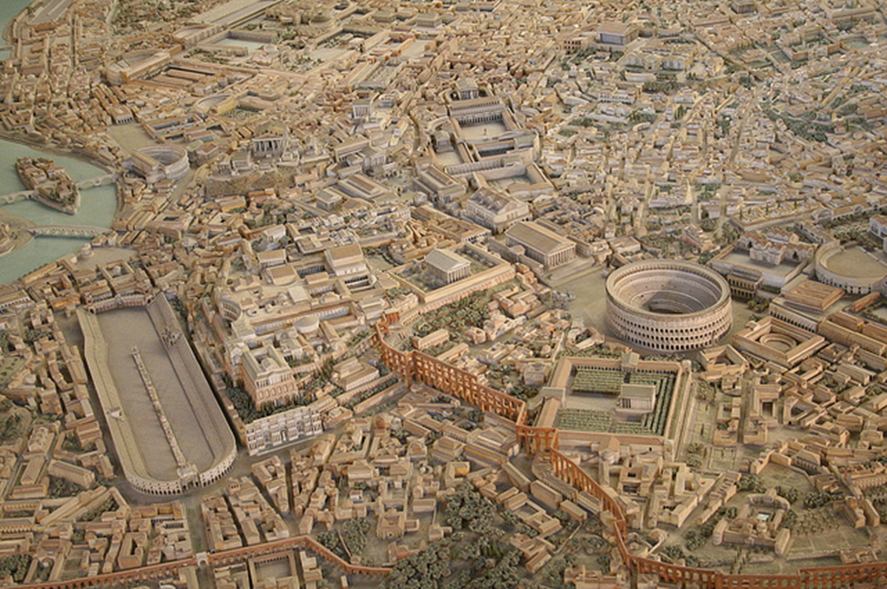
INTRODUCTION – HISTORICAL DEVELOPMENT AND THE SYSTEM OF ROMAN LAW
ROMAN PRIVATE LAW, 2017/2018
LECTURE ASSOC. PROF. KARLOVIĆ

Slide 2
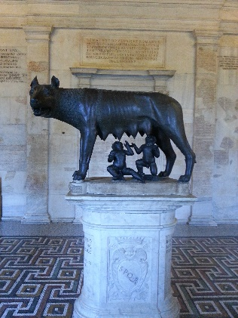
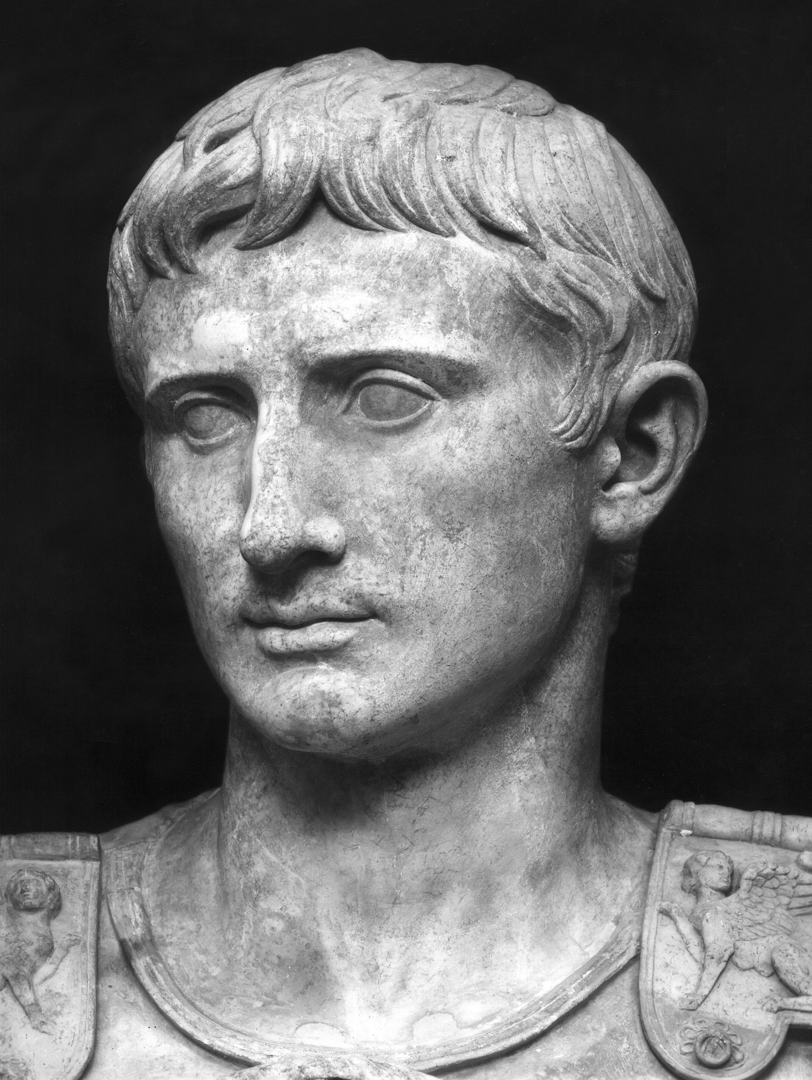
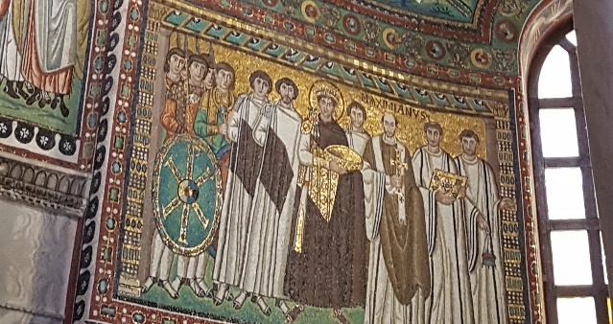
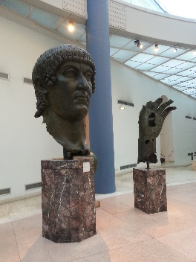
754
242
201
27
0
235
565
IUS PRAETORIUM (201 – 27 BC)
CLASSICAL LAW (27 BC – 235 AD)
POSTCLASSICAL LAW (235 – 565 AD)
IUS CIVILE
(754 – 201 BC)
REPUBLIC
PRINCIPATE
DOMINATE
KINGDOM AND REPUBLIC

Slide 3
754
242
201
0
235
565
IUS PRAETORIUM (201 – 27 BC)
CLASSICAL LAW (27 BC – 235 AD)
POSTCLASSICAL LAW (235 – 565 AD)
IUS CIVILE
(754 – 201 BC)
REPUBLIC
PRINCIPATE
DOMINATE
KINGDOM AND REPUBLIC

Slide 4
754
242
201
0
235
565
IUS PRAETORIUM (201 – 27 BC)
CLASSICAL LAW (27 BC – 235 AD)
POSTCLASSICAL LAW (235 – 565 AD)
IUS CIVILE
(754 – 201 BC)
Close connection between legal (ius) and religious rules (fas)
Formalism, strict rules (ius cogens), limited number of legally recognized (enforceable) contracts and modes of acquisition of ownership
Development of law – legislation - acts enacted in the assemblies
The Twelve Tables – 451/450 BC

Slide 5
754
242
201
27
0
235
565
IUS PRAETORIUM (201 – 27 BC)
CLASSICAL LAW (27 BC – 235 AD)
POSTCLASSICAL LAW (235 – 565 AD)
IUS CIVILE
(754 – 201 BC)
254/253 BC – Tiberius Coruncanius – pontifical interpretatio - laity
242 BC – praetor peregrinus – ius gentium – informal, based on good faith (bonae fidei)
development of ius honorarium – procedural remedies
D. 1,1,7,1: Ius praetorium est, quod praetores introduxerunt adiuvandi vel supplendi vel corrigendi iuris civilis gratia propter utilitatem publicam.
Dual legal systems

Slide 6
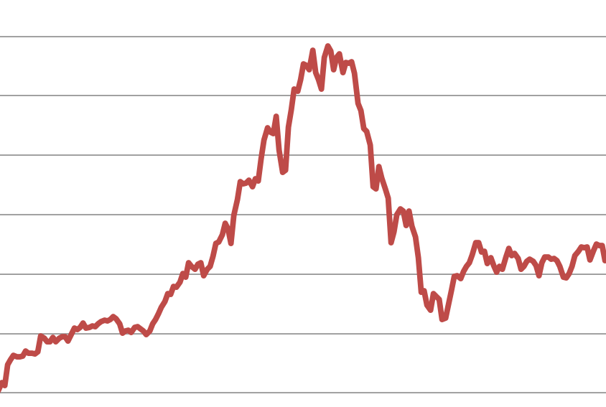
754
242
201
27
0
235
565
IUS PRAETORIUM (201 – 27 BC)
CLASSICAL LAW (27 BC – 235 AD)
POSTCLASSICAL LAW (235 – 565 AD)
IUS CIVILE
(754 – 201 BC)
Classical jurisprudence
Schools of law – Sabinians and Proculians
Gaius Institutiones
Papinianus, Paulus and Ulpianus
peak of development
plurality = elaborate explanations
Servius Sulpicius Rufus
Aulus Ofilius – friend of Caesar
Ateius Capito – traditionalist
Trebatius
Marcus Antistius Labeo – 400 volumes of text
Cornelius Maximus
Tubero – archaic style
Q. M. Scaevola
Massurius Sabinus
Nerva
Aquillius Gallus
Alfenus Varus

Slide 7
754
242
201
0
235
565
IUS PRAETORIUM (201 – 27 BC)
CLASSICAL LAW (27 BC – 235 AD)
POSTCLASSICAL LAW (235 – 565 AD)
IUS CIVILE
(754 – 201 BC)
Dominate – decline
Imperial legislation
Lex citationis 426 AD
Legal collections and codifications
Collections of constitutiones (leges):
1. Codex Gregorianus
2. C. Hermogenianus
3. C. Thedosianus
Barbarian codes:
1. Lex Romana Visigothorum
2. L. R. Burgundionum
3. Edictum Theoderici
Collections of ius and leges:
1. fragmenta Vaticana
2. Collatio legum R. et M.
3. Syro-Roman Lawbook

Slide 8
754
242
201
0
235
565
IUS PRAETORIUM (201 – 27 BC)
CLASSICAL LAW (27 BC – 235 AD)
POSTCLASSICAL LAW (235 – 565 AD)
IUS CIVILE
(754 – 201 BC)
Justinian′s codification:
a) Codex Iustinianus (529)
b) Digesta (Pandectae) (533)
c) Institutiones (533)
d) Codex repetitae praelectionis (534)
+ Novellae (535 – 565)

Slide 9
I. SYSTEM OF LAW
Gai. Inst. 1,8: Omne autem ius, quo utimur, vel ad personas pertinet vel ad res vel ad actiones.
IUS
PERSONAE
RES
ACTIONES
RES CORPORALES – REAL PROPERTY
RES INCORPORALES – OBLIGATIONS, INHERITANCE

Slide 10
II. OBLIGATIONS

Slide 11
III. CONTRACTS

