Slide 1
Emptio venditio – Contract of Sale III. Transfer of ownership and the problem of risk (periculum)
ROMAN PRIVATE LAW, 2016/2017
LECTURE DOC. KARLOVIĆ

Slide 2
Transfer of ownership
TITULUS
MODUS
Mancipatio - res mancipi
Traditio – res nec mancipi
DOMINIUM
OWNERSHIP
Sale

Slide 3
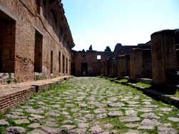
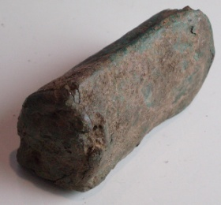
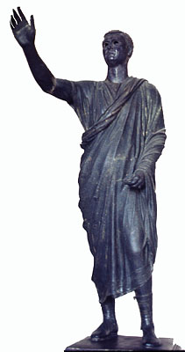
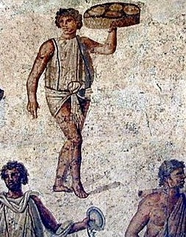
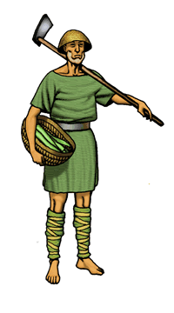
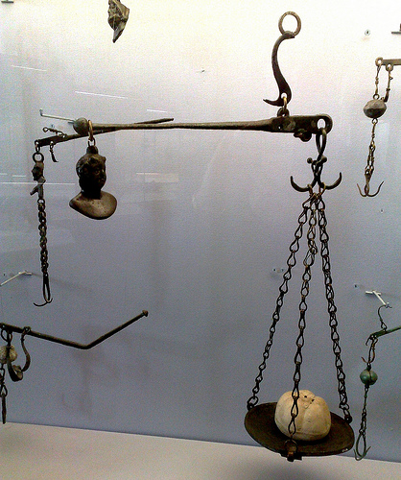
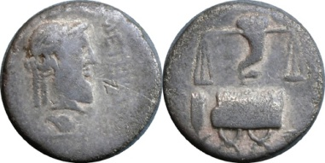
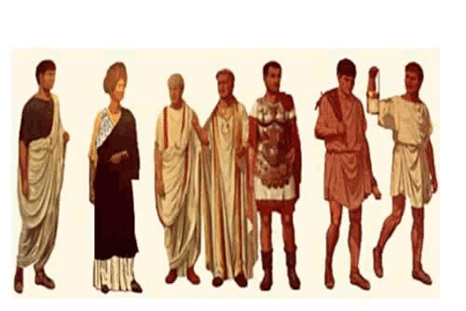
MANCIPATIO
LIBRIPENS
Ostia

Slide 4
EMPTIO PUELLAE (AD 139)
Maximus Batonis puellam nomine / Passiam sive ea quo alio nomine est an/norum // circiter p(lus) m(inus) // sex // empta sportellaria // emit mancipioque accepit / de Dasio Verzonis Pirusta ex Kaviereti[o] / |(denariis) ducentis quinque / iam puellam sanam esse a furtis noxisque / solutam fugitivam erronem non esse / praestari quot si quis eam puella{a}m / partemve quam ex eo quis evicerit / quominus Maximum Batonis quo/ve ea res pertinebit habere possi/dereque recte liceat tum quanti / ea puella empta est tam pecuniam // et alterum tantum dari fide rogavit / Maximus Batonis fide promisit Dasius / Verzonis Pirusta ex Kaviereti(o) / proque ea puella quae s(upra) s(cripta) est |(denarios) ducen/tos quinque accepisse et habere / se dixit Dasius Verzonis a Maximo Batonis / actum Karto XVI K(alendas) Apriles / Tito Aelio Caesare Antonino Pio II et Bruttio / Praesente II co(n)s(ulibus) // Maximus Batonis puellam / nomine Passiam sive ea / quo alio nomine est anno/rum circiter p(lus) m(inus) sex emp/ta sportellaria emit man/cipioque accepit de / Dasio Verzonis Pirusta / ex Kavieretio |(denariis) ducen/tis et quinque / sanam esse / eam puellam furtis no/xaque solutam fugi/tivam erronem non / esse praestari quot / si quis eam puellam / partemve quam ex e<a=O> / quis evicerit quo / minus Maximum Ba/tonis quo/ve ea re[s pertinebit habere possidereque recte liceat tum quanti ea puella empta est tam pecuniam et alterum tantum dari fide rogavit Maximus Batonis fide promisit Dasius Verzonis Pirusta ex Kaviereti proque ea puella quae s(upra) s(cripta) est |(denarios) ducentos quinque accepisse et habere se dixit Dasius Verzonis a Maximo Batonis actum Karto XVI K(alendas) Apriles Tito Aelio Caesare Antonino Pio II et Bruttio Praesente II co(n)s(ulibus)] // Maximi Ve/neti princi/pis / Masuri Messi / dec(urionis) / Anneses An/dunocnetis / Plani Verzo/nis Sclaietis / Liccai Epicadi / Marciniesi / Epicadi / Marciniesi / Epicadi Plaren/tis qui et Mico / Dasi Verzonis / ipsius vendi/toris

Slide 5
Payment of the price as a condition for the transfer of ownership
D. 18.1.19 Pomponius libro 31 ad Quintum Mucium
Quod vendidi non aliter fit accipientis, quam si aut pretium nobis solutum sit aut satis eo nomine factum vel etiam fidem habuerimus emptori sine ulla satisfactione.
When I sell something, it becomes the property of the recipient only if I have received the price or have accepted security in respect thereof or the purchaser has been given credit withour security.
Gai. Inst. II, 18-20
18. Magna autem differentia est inter mancipi res et nec mancipi. 19. Nam res nec mancipi ipsa traditione pleno iure alterius fiunt, si modo corporales sunt et ob id recipiunt traditionem. 20. Itaque si tibi uestem uel aurum uel argentum tradidero siue ex uenditionis causa siue ex donationis siue quauis alia ex causa, statim tua fit ea res, si modo ego eius dominus sim.
There is a great difference between res mancipi and res nec mancipi. 19. Namely, res nec mancipi become others ownership just by traditio (handing over), if they are corporeal and can be handed over. 20. The same way if I hand you over some piece of clothing or gold or silver plate becuase of a sale or gift or some other legal cause, the object becomes yours immediately, if I was the owner.

Slide 6
Just. Inst. II, 1, 40-41
40. Per traditionem quoque iure naturali res nobis adquiruntur: nihil enim tam conveniens est naturali aequitati, quam voluntatem domini, volentis rem suam in alium transferre, ratam haberi. et ideo cuiuscumque generis sit corporalis res, tradi potest et a domino tradita alienatur. Itaque stipendiaria quoque et tributaria praedia eodem modo alienantur. Vocantur autem stipendiaria et tributaria praedia quae in provinciis sunt, inter quae nec non Italica praedia ex nostra constitutione nulla differentia est.
41. Sed si quidem ex causa donationis aut dotis aut qualibet alia ex causa tradantur, sine dubio transferentur: venditae vero et traditae non aliter emptori adquiruntur, quam si is venditori pretium solverit vel alio modo ei satisfecerit, veluti expromissore aut pignore dato. Quod cavetur quidem etiam lege duodecim tabularum: tamen recte dicitur et iure gentium, id est iure naturali, id effici. sed et si is qui vendidit fidem emptoris secutus fuerit, dicendum est, statim rem emptoris fieri.
…: sold and handed over objects do not become the ownership of the purchaser, unless the price is paid to the seller or he is satisfied (secured) in some other way, for example by the guarantor or by the given pledge.

Slide 7
Ownership and periculum
Accidental loss of object of sale in the period between the sale and the transfer of possession (ownership)
Casum sentit dominus
Periculum est emptoris

Slide 8
Problems regarding periculum:
1. When is the sale perfect?
2. When the risk is transferred to the purchaser?
3. Why is the sale of wine so special? Which are the modes to keep and sell wine?
4. What (which sorts of risk) is comprised by the concept of periculum?
5. How does the mora debitoris/creditoris influence the rule on transfer of risk?
6. What is the situation in contemporary legal systems?

Slide 9
Ownership and periculum - Casum sentit dominus vs. Periculum est emptoris
PERICULUM EMPTORIS
PERICULUM VENDITORIS
France, Italy
Louisiana, Quebec
Switzerland
Germany, Austria
TRANSFER OF OWNERSHIP BY SALE
TRANSFER OF OWNERSHIP BY TRADITIO

Slide 10
Questions (repetitorium):
1. What are essentialia negotii of sale?
2. Is there a difference between sale and exchange?
Which school prevailed regarding this issue.
Substantiate by texts from the Digest.
3. Is there a specific form required for sale to be legally enforceable?
4. Can the contract of sale be concluded between absent parties?

Slide 11
5. Which feature of sale is explained by the next text?
D. 19.1.13.8 (Ulpianus libro 32 ad edictum) Offerri pretium ab emptore debet, cum ex empto agitur, et ideo etsi pretii partem offerat, nondum est ex empto actio: venditor enim quasi pignus retinere potest eam rem quam vendidit.
When an action is brought on purchase, the buyer should tender (offer) the price. Therefore if he should tender part of the price, there is not yet an action on purchase; for the seller can keep the object of sale as a sort of pledge.

Slide 12
6. Which part of formula of actio empti gives the judge wide authority to adjudicate the issues between the parties?
Titius iudex esto,
Quod Aulus Agerius de Numerio Negidio hominem quo de agitur emit, qua de re agitur, (demonstratio)
quidquid ob eam rem Numerium Negidium Aulo Agerio dare facere oportet ex fide bona (intentio)
eius T. iudex Numerium Negidium Aulo Agerio condemnato, si non paret absolvito. (condemnatio)
Titius will be judge; whereas Aulus Agerius bought the man who is the subject of the action from Numerius Negidius, which matter is the subject of the action, whatever on account of that matter Numerius Negidius ought to give to or do for Aulus Agerius in good faith, for the value of that let the judge condemn Numerius Negidius to Aulus Agerius; if it does not appear, let him absolve.

Slide 13
7. What is arrha? What is its effect on the contract of sale?
8. What can be the object of sale? Can the parties agree that the fisherman will sell his whole catch of fish? How can this be agreed upon?
9. Can the parties agree to sell a temple dedicated to Jupiter?
10. Explain the following text:
D. 18.1.8.2. Liberum hominem scientes emere non possumus. Sed nec talis emptio aut stipulatio admittenda est: "cum servus erit", quamvis dixerimus futuras res emi posse: nec enim fas est eiusmodi casus exspectare.
We cannot knowingly buy a freeman, nor is a sale or stipulation allowed with the provision „when he shall become a slave”, even though we have said that the sale of future things is possible, for it is contrary to morality to anticipate such a contingency.

Slide 14
11. Explain the following features of price:
1. Nummerata pecunia
2. Pretium certum
3. Pretium verum
4. Pretium iustum
12. What is laesio enormis?

Slide 15
13. Explain the rule periculum est emptoris? What are the exceptions to this rule?
14. When is the ownership od sold thing transferred to buyer?

Slide 16
Warranty of title
Warranty – part of the contract of sale?
Express or implied part of sale?
The extent of responsibility?
Action to be used?
Competition of different actions?

