Slide 1
English for Lawyers 2
Lecturer: Miljen Matijašević
e-mail: miljen.matijasevic@gmail.com
Session 1, 27 Feb 2018

Slide 2
Introduction to the Course
Engleski jezik pravne struke 2

Slide 3
English for Lawyers 2 – Course outline
Coursebook: Sočanac, L., Matijašević, M., Javornik Čubrić, M., Husinec, S., Horvatić Bilić, I., English for the Legal Profession, Narodne novine d.d., 2017.
stranica Katedre: www.pravo.hr/sj
predmeti – Engleski jezik pravne struke II
obavijesti
teaching materials – Miljen Matijašević

Slide 4
English for Lawyers 1 – Course outline
Module Two:
Anglo-American Legal systems

Slide 5
English for Lawyers 2 – syllabus
 | DATE | CONTENT
1 | 27 Feb 2018 | Introduction to the Course
2 | 6 Mar 2018 | The Sources of English Law
3 | 13 Mar 2018 | The Hierarchy of English Courts
4 | 20 Mar 2018 | The Doctrine of Precedent
5 | 27 Mar 2018 | Parliament and Legislation
6 | 3 Apr 2018 | The Legal Profession
7 | 17 Apr 2018 | American Federalism
8 | 24 Apr 2018 | The Executive Branch in the USA (ODRADA!)
9 | 8 May 2018 | The Supreme Court of the USA
10 | 15 May 2018 | Final Revision
11 | 22 May 2018 | End-of-term test
12 | 29 May 2018 | Signatures and Tutorials

Slide 6
Attendance
Optional
Regular attendance
(missing no more than 3 sessions)
opportunity to take the end-of-term exam
(two weeks before the first regular term)
opportunity to do a presentation

Slide 7
Early exam (kolokvij)
22 May
Only available with regular attendance
(missing no more than 3 sessions)
Za upis ocjene u indeks i ISVU potrebno prijaviti ispit na redovnom roku i doći na upis ocjene TIJEKOM redovnog roka (u dogovoreno vrijeme)

Slide 8
The final examination
TEST: Mastering relevant vocabulary
ORAL EXAM: Being able to talk about the topics covered in the syllabus, using relevant terms

Slide 9
The final examination
problems with English?
take steps in time!
come and talk to me – there is help available!
STUDENT-MENTORS

Slide 10
SUMMARY
Attendance optional but with benefits
Collect the signature in time!!
Whenever in doubt talk to ME!
You are not responsible to me but to YOURSELF!

Slide 11
Optional student assignment
carrying out research and doing a presentation
research tasks at the end of each unit in the coursebook
additional topics may be chosen

Slide 12
Presentations
duration: approx. 15 minutes
2-3 students prepare each presentation as a joint project

Slide 13
Presentations
REWARD for participating in a successful presentation:
you can SKIP the oral examination
HOWEVER...
you still have to take the written test
you MUST attend the classes

Slide 14
Presentations
Before giving the presentation, students MUST:
consult the lecturer about the topic
consult the lecturer about the sources
show the entire PP presentation, as well as the outline and notes at least two weeks before giving the presentation
consult the lecturer about the pronunciation of difficult words

Slide 15
Presentations
RESOURCES
Department library (come and talk to me)
Tempus reading room
TMT 3, weekdays 10-14
online resources

Slide 16
Hints for a successful presentation
DOs:
involve the audience
study your sources and compile the most interesting bits of information into your presentation
make eye contact with your audience
address your audience and use plain English
include questions and discussion questions

Slide 17
Hints for a successful presentation
DON’Ts:
copy from source word for word
read from a piece of paper – it’s BORING!!!
include full, complex sentences on your slides
use language you don’t understand
suffocate the presentation with images and animations (especially if you do not make use of them!)

Slide 18
Remember what we have learned…

Slide 19
Separation of powers
The Legislative
The Executive
The Judiciary

Slide 20
Legal terms
Remember the difference:
legislation
the legislative
the legislature
the judiciary
judicial

Slide 21
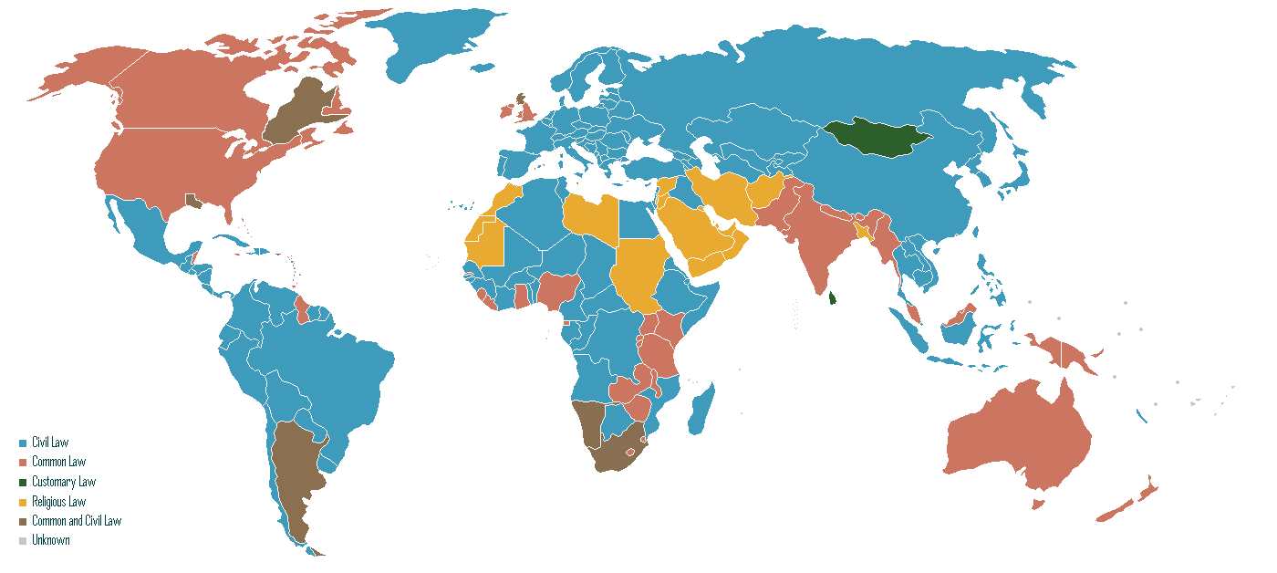
Legal systems of the world

Slide 22
Legal traditions
 | CIVIL LAW | COMMON LAW
MAIN SOURCE OF LAW
LAW-MAKING BODIES
CREATION OF LEGAL PRINCIPLES
ROLE OF THE JUDICIARY
TYPE OF LEGAL PROCEDURE

Slide 23
Legal traditions
 | CIVIL LAW | COMMON LAW
MAIN SOURCE OF LAW | legislation (codified law) | case law (precedents)
LAW-MAKING BODIES | legislative bodies | the judiciary
CREATION OF LEGAL PRINCIPLES | from general and abstract | from specific and individual
ROLE OF THE JUDICIARY | interprets and applies the law | creates the law
TYPE OF LEGAL PROCEDURE | inquisitorial | adversarial

Slide 24
Thank you for your attention!

